Slide 1
Curate Collaborate, Create
Harnessing the collaborative power of web technologies.
Stephanie Wirt and Stephanie Pickens

Slide 2
What’s the setting?
Powhatan High School - Virginia
Forsyth High School Georgia
2nd Year Photography
BYOD School
Limited Hardware/Software Access
Diverse socio-economic
My Big Campus online
BYOT Initiative
Computer lab in classroom with the latest digital software
Limited online social media access at school
High income, college bound demographic

Slide 3
Collaboration Across State Lines
Using web technologies classes in different states share ideas, images, and research in order to create new artwork.

Slide 4
Setting the Stage for Collaboration

Slide 5
Collaborative Art Creation The Process
Day 1-2 Introduction - Discussion – Research
Notes:
After introducing students to Surrealism as an artistic style and exploring historical and contemporary surrealistic artists each class individually discussed the concept of transformation and what. They were able to share their ideas with students at the partner school through discussion boards on course sites.
Discuss student concept of transformation, image usage and share Pinterest board links – (Coursesites)

Slide 6
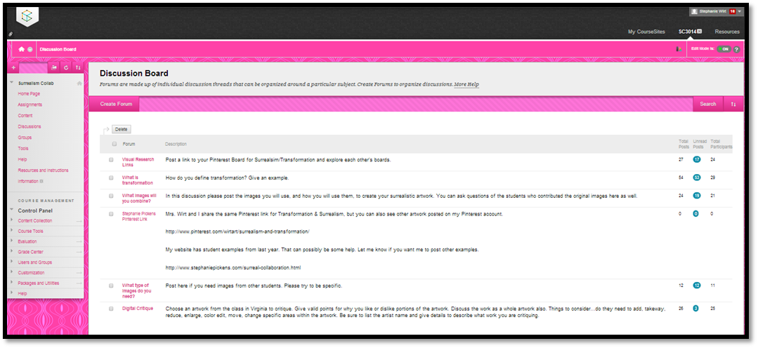
Communication is the key to collaboration!
Digital Documentation as a bonus!
Notes:
Discussion board topics grew as students shared their ideas about transformations, asked each other questions about images and critiqued individual works along the way.

Slide 7
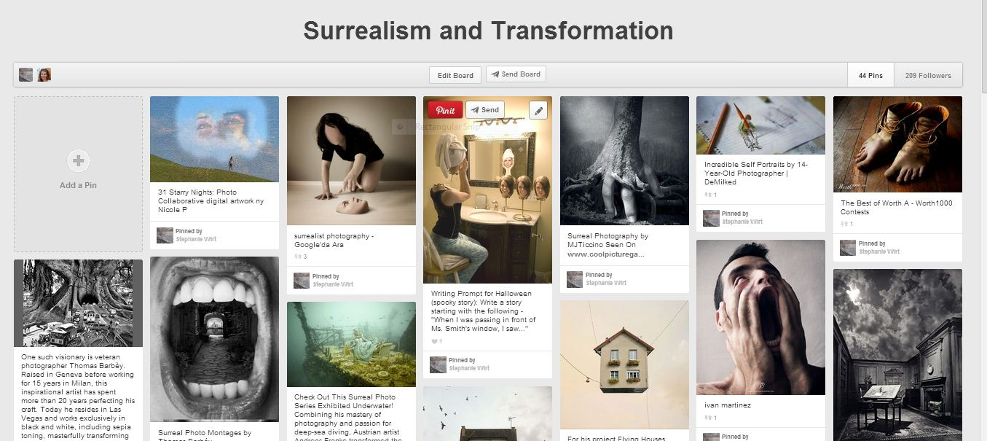
Research like a Curator
To Curate - to pull together, sift through, and select for presentation their visual research.
Notes:
Research Surrealism, Altered Photography, Transformation (Pinterest = Art History Lesson)

Slide 8
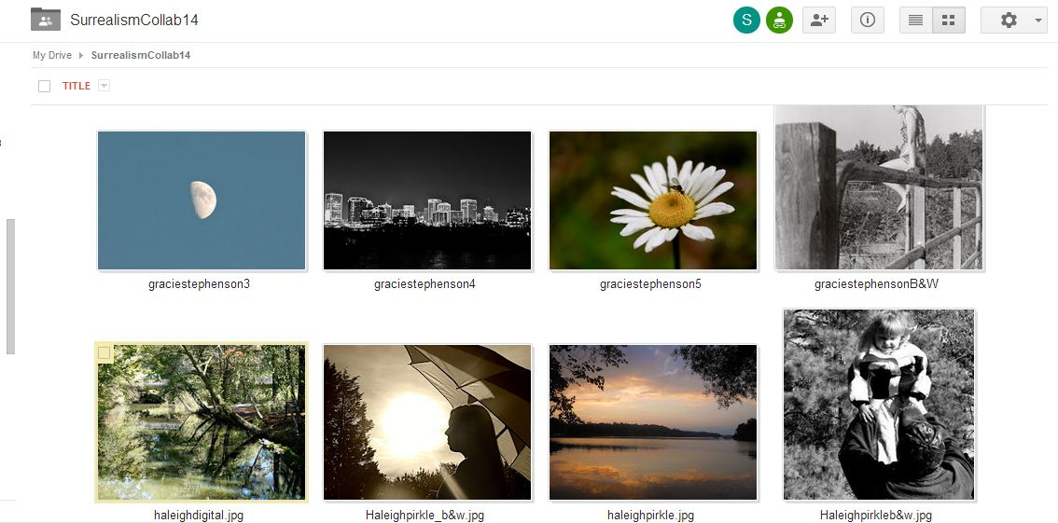
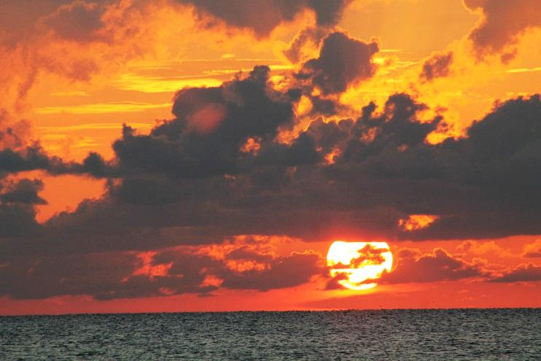
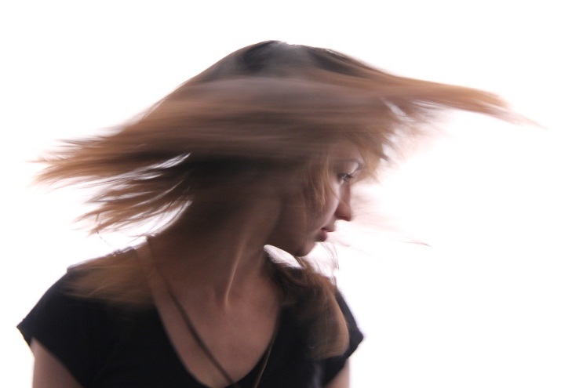
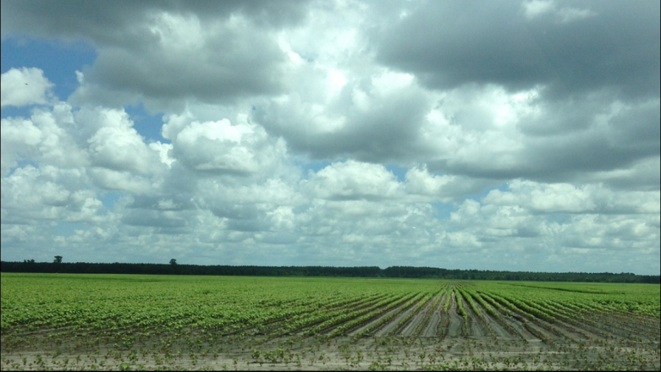
Day 2-3 – Contribute – Plan – Collaborate
Notes:
Students from both schools contributed their images to a shared Google folder. This was gave us an opportunity to discuss the difference between copyright infringement, appropriation and collaboration.

Slide 9
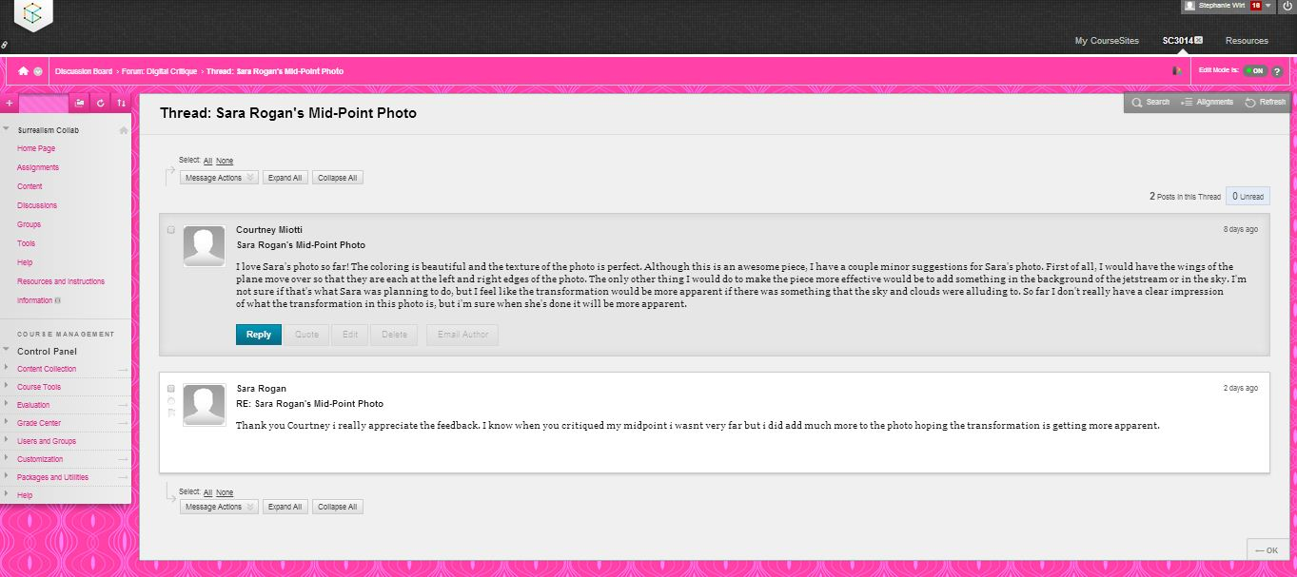
Collaborative Art Creation The Process
Day 4-5 – Create – Collaborate – Create

Slide 10
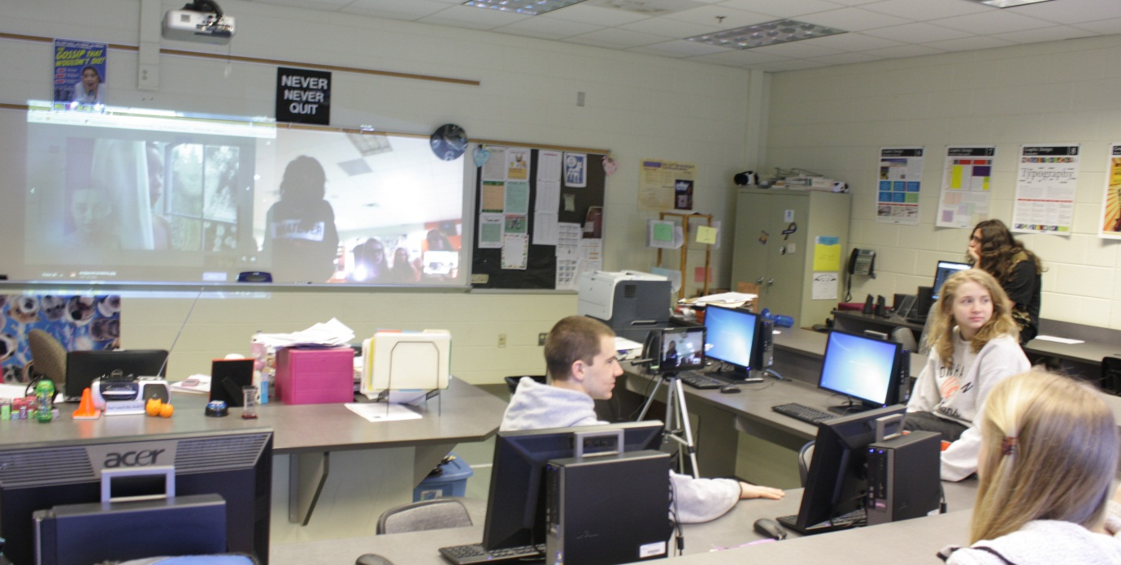
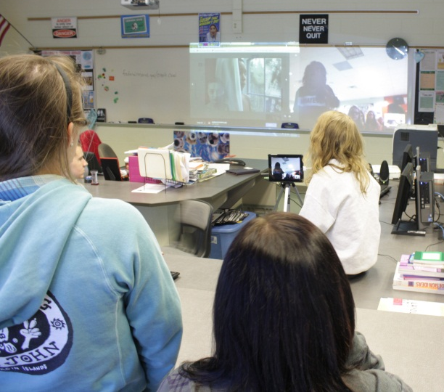
Putting a Face to the Artist Skype Makes it Happen!
Multiple Devices Make this Possible

Slide 11
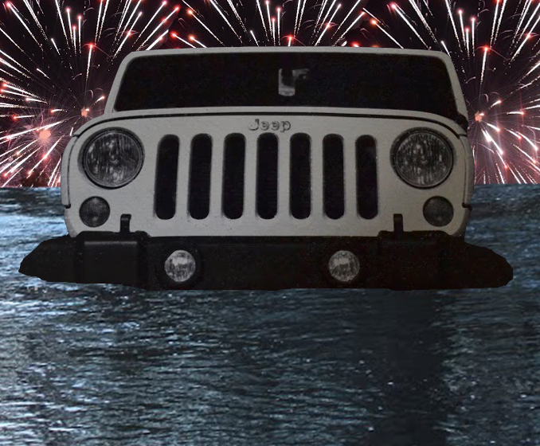
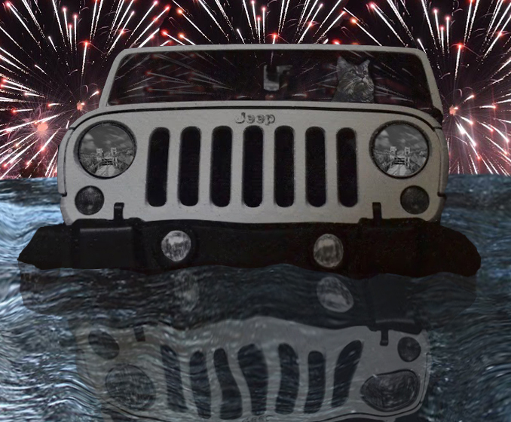
Making Changes After Critiques
PHS
Student
Art

Slide 12
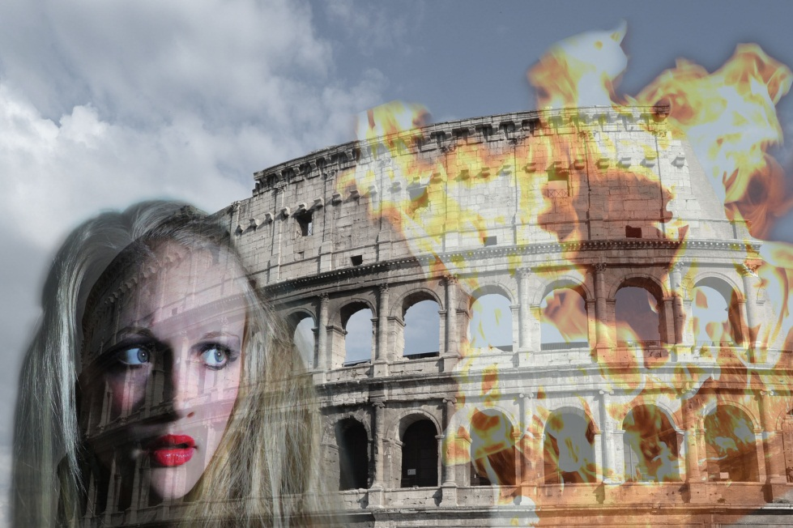
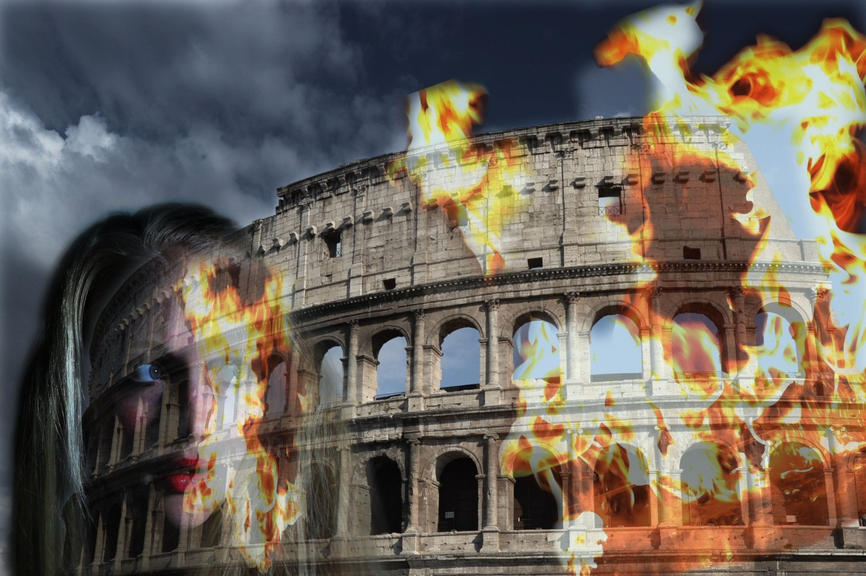
Making Changes After Critiques
FHS
Student
Art

Slide 13
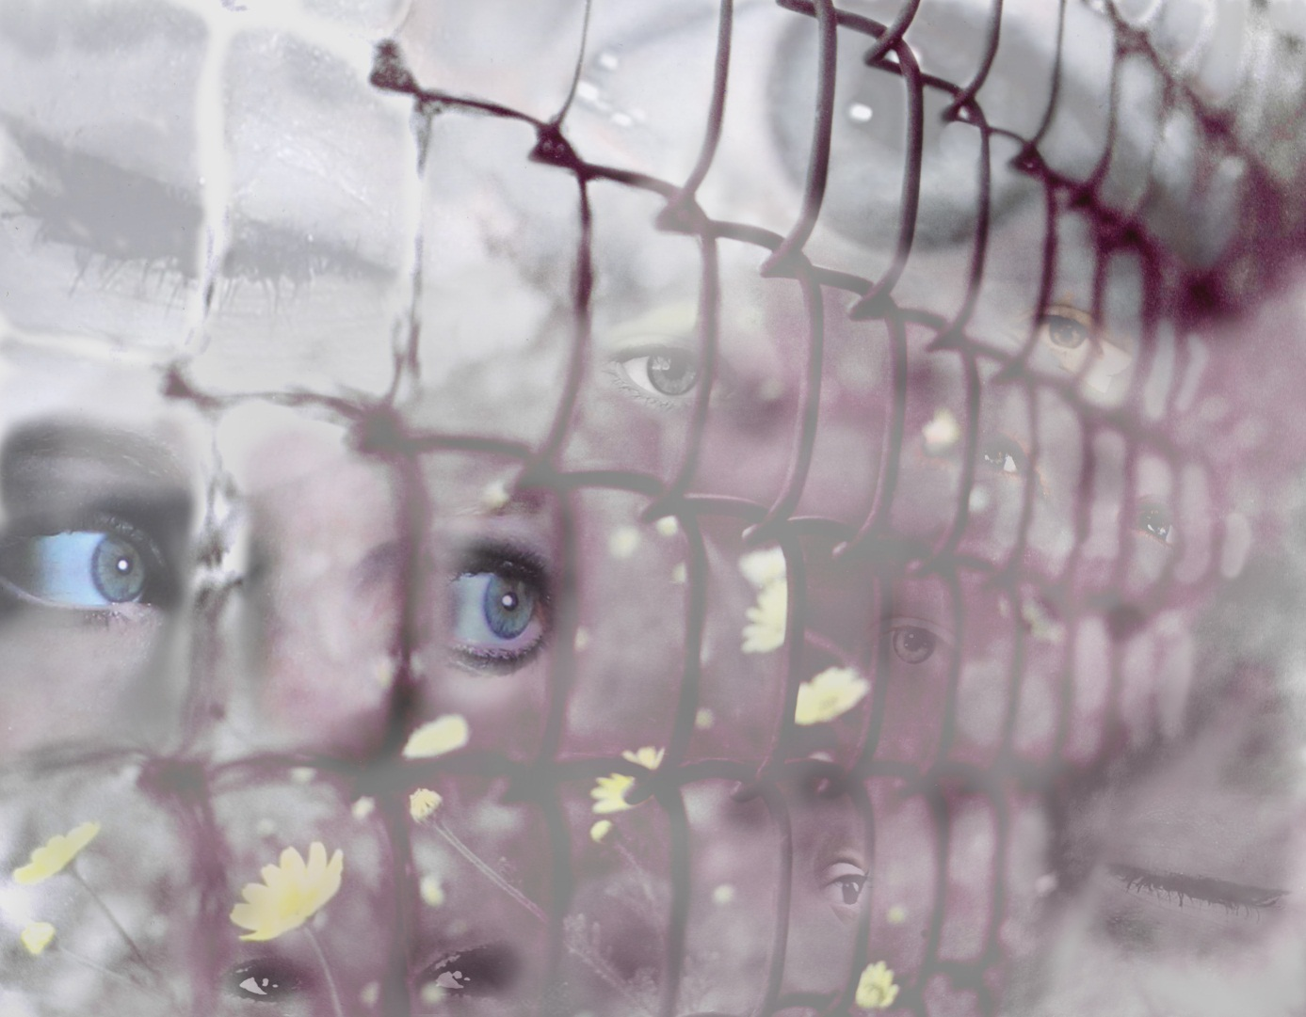
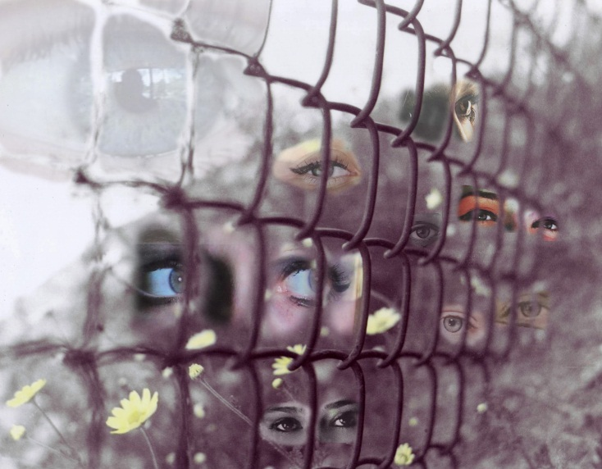
Making Changes After Critiques
PHS
Student
Art

Slide 14
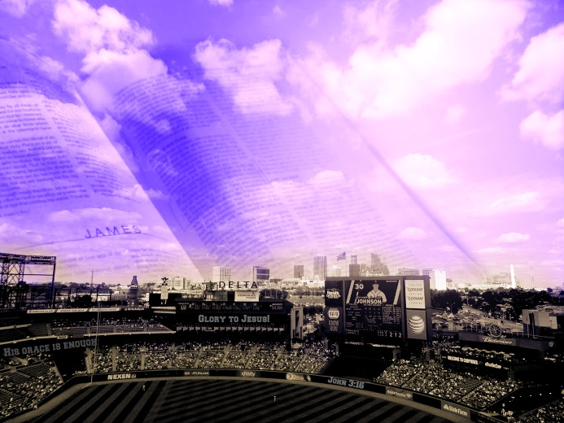
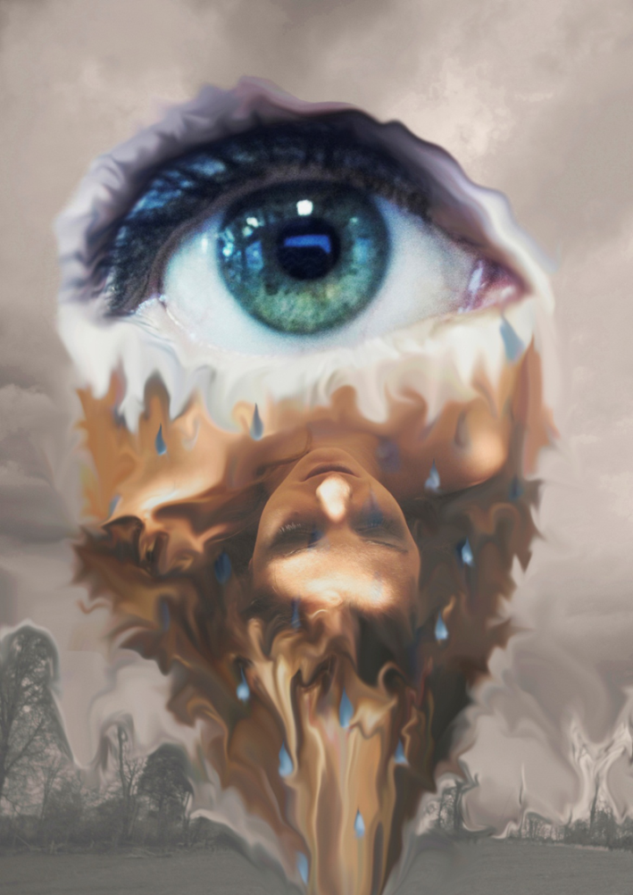
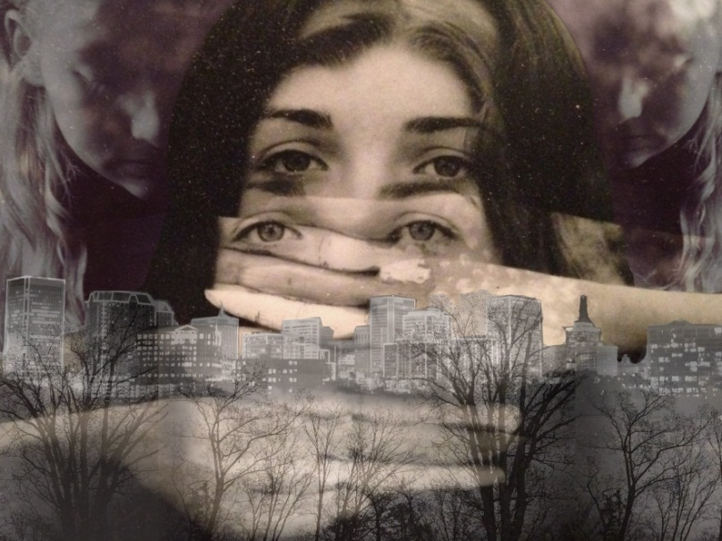
Surrealistic Interpretation of Transformation
FHS
Student
Art

Slide 15
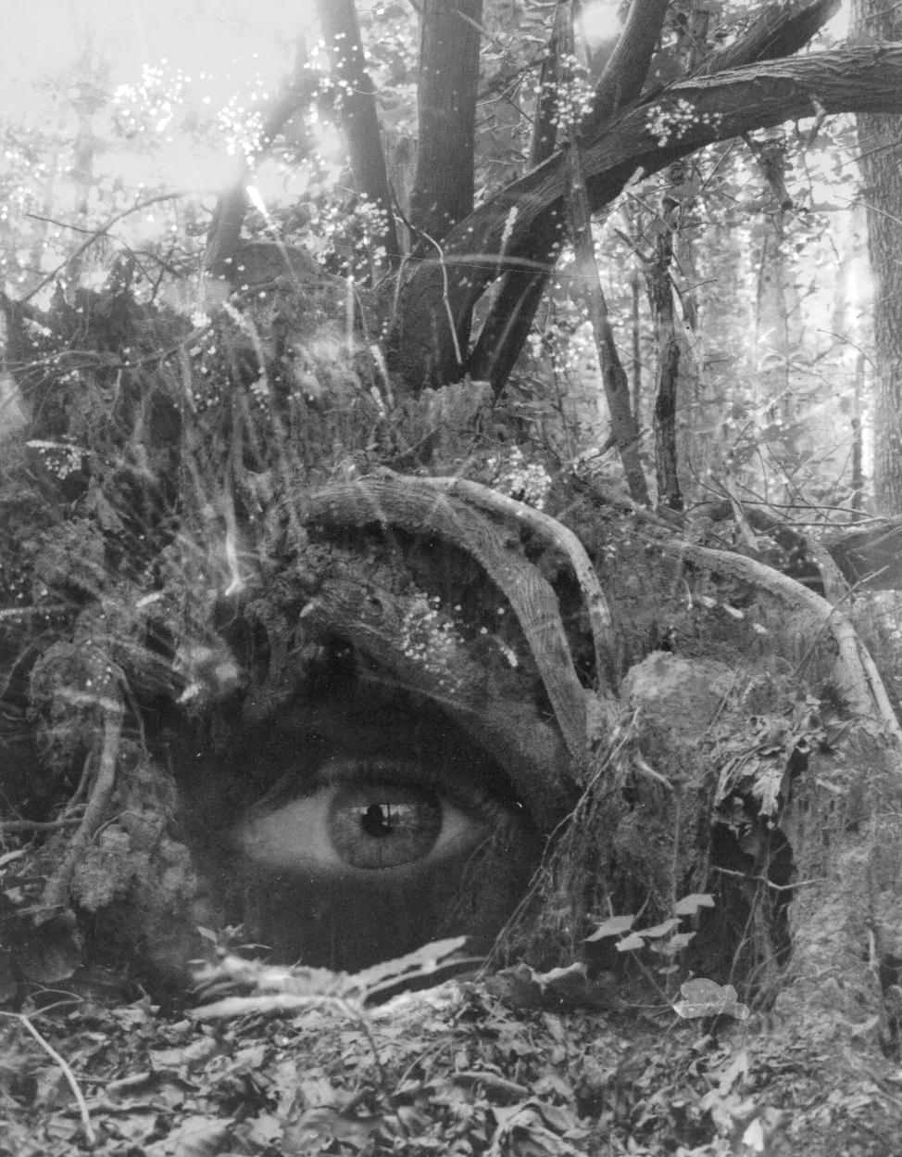
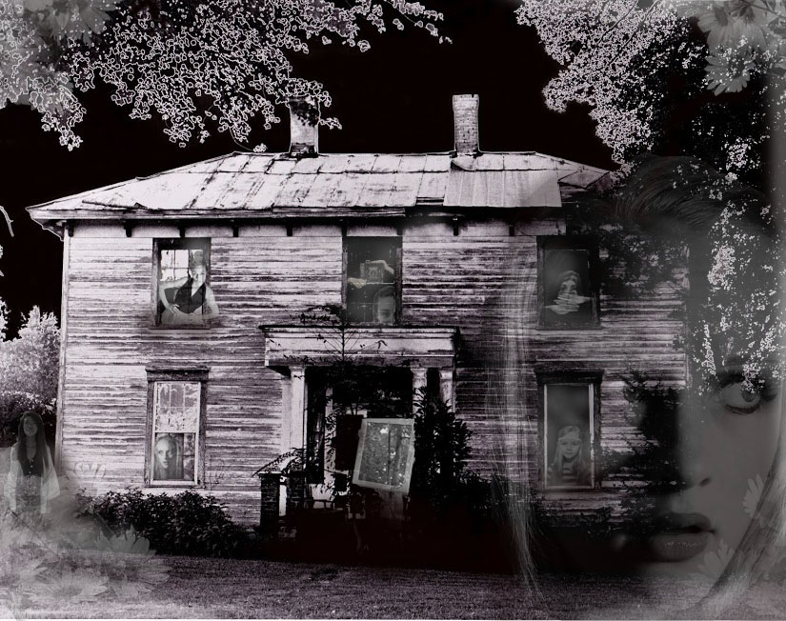
Surrealistic Interpretation of Transformation
PHS
Student
Art

Slide 16
Surrealistic Interpretation of Transformation

Slide 17
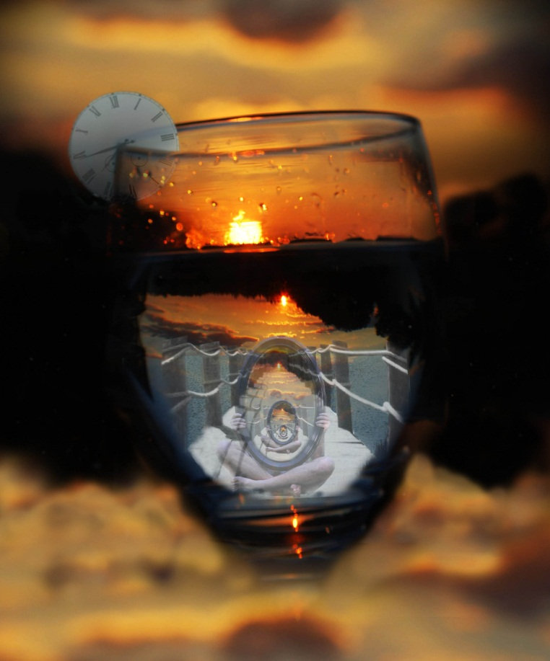
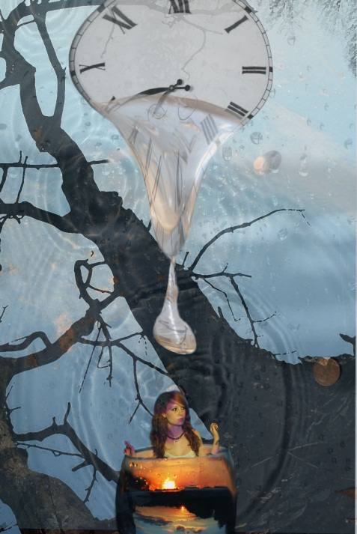
Variation on the Concept
Notes:
Here we can talk about the differences in the project over 2 years

Slide 18
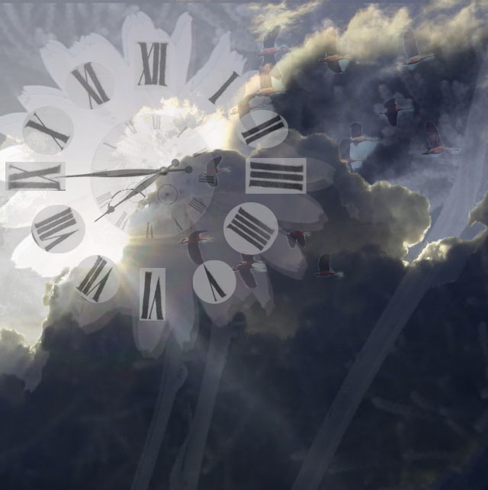
Surrealistic Interpretation of Time
2013
Student
Art

Slide 19
Collaborative Photo Project
Ethical Use of Images
Combining Traditional and Digital Media
Using Prompts to Build Problem Solving Skills
Web Technologies for Research and Collaboration
Building Bridges Between States
Documenting Learning Process

Slide 20
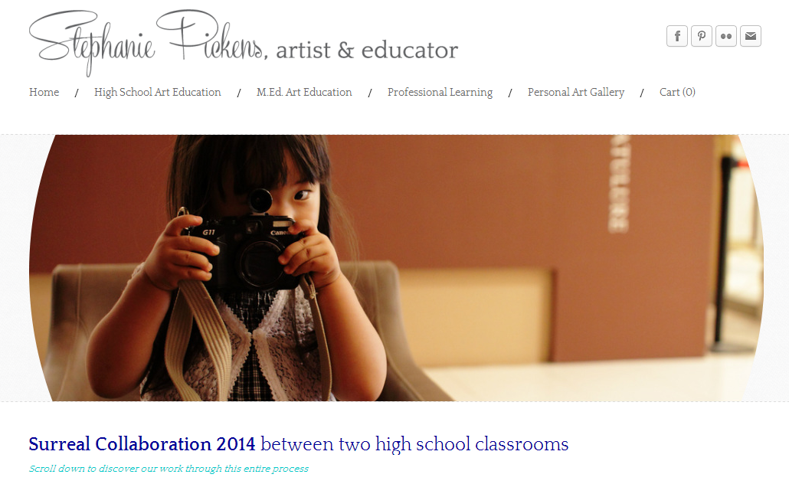
More Information
www.wirtartalk.org
www.stephaniepickens.com

