Slide 1
Pinning your Flickr is Delicious
Professional Learning Networks in the high school setting.
How can utilizing digital and web technologies enhance instruction and student learning in the arts?
Stephanie Wirt
Powhatan High School • Powhatan, Virginia
Stephanie Pickens
West Forsyth High School • Cumming, Georgia

Slide 2
And the setting is………
Wirt
Pickens
Limited access to technology
Limited access with student owned devices
Student in school access to some online social media
Wide range of low to high income, mostly college bound
BYOT Initiative
Computer lab in classroom with the latest digital software
Limited online social media access at school
High income, college bound demographic

Slide 3
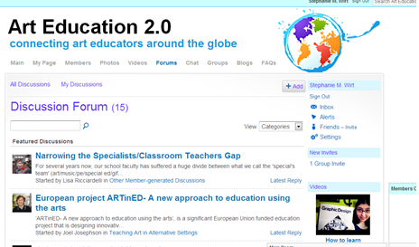
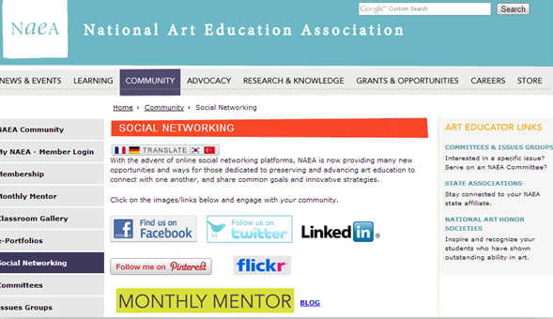
What’s a PLN?
Personal Learning Network

Slide 4
Planning, Professional Development, Productivity
Closed Networks | Open Networks | Web Based Productivity
Course Sites (PHS only) Edmodo (WFHS-like FB) Angel Learning (WFHS only) Arted2.0 | Flicker (Portfolio Space) Pinterest (Visual Research) Delicious is Delicious no More Scoop It Learnist Facebook YouTube TeacherTube Lynda.com (Photoshop tutorial house) Personal Websites | DropBox (file storage & sharing) Google Drive (file storage & sharing) Email Skype Texting

Slide 5
Student PLNs
PHS
WFHS
Course Sites
Pinterest
Flickr
Email
Video
Skype (schedule conflicts)
Wirtarttalk.org
Edmodo
Pinterest (blocked at school)
Flickr (blocked at school)
Email
Lynda
Video
Skype (schedule conflicts)
Stephaniepickens.com

Slide 6
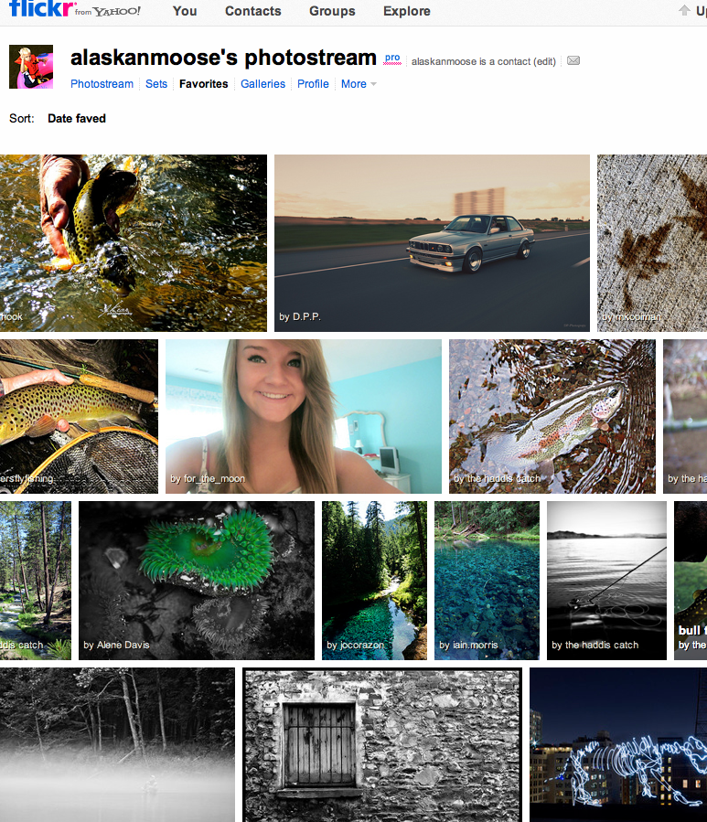
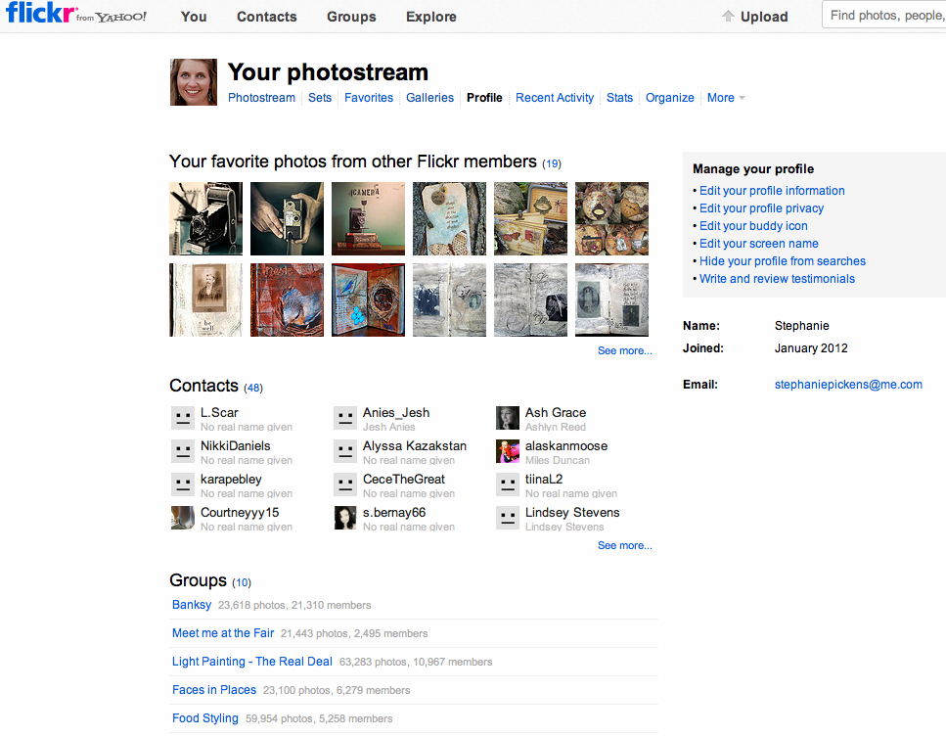
What’s the Point of Flicker?
Means of collaboration for both students and teachers
Free Digital Portfolio & Critiquing Space
Paid Version for AP Portfolio students
PHS students upload to flicker with their phones and school desktops

Slide 7
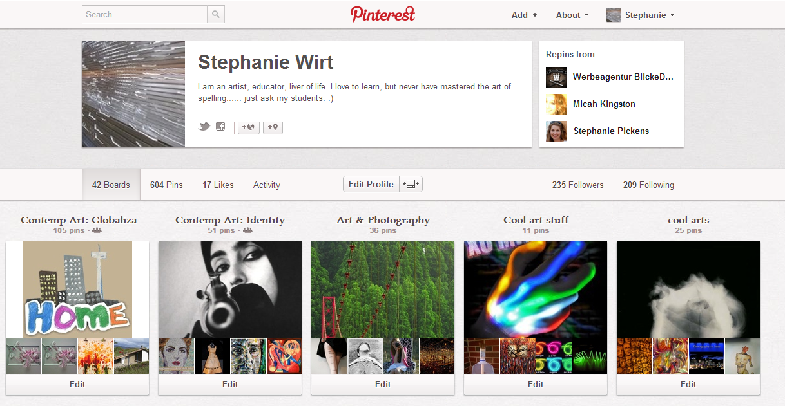
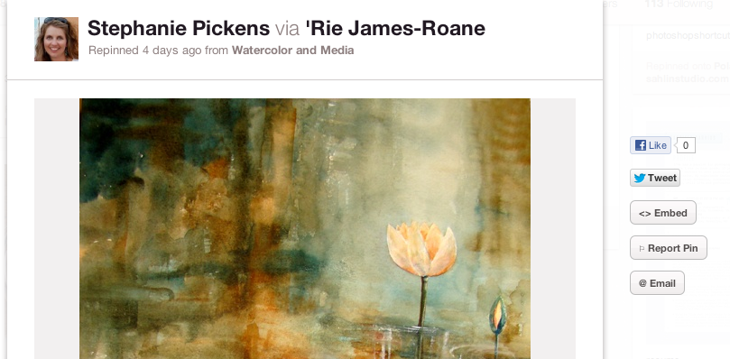
“Pinning It” as Visual Research
Teachers use this PLN for instruction
Pin lessons–plans and ideas
Research
Creating Boards for classroom instruction
Collaborating with other educators and students
How students use it to document research
Research
Annotated Bibliographies
Means of collaboration

Slide 8
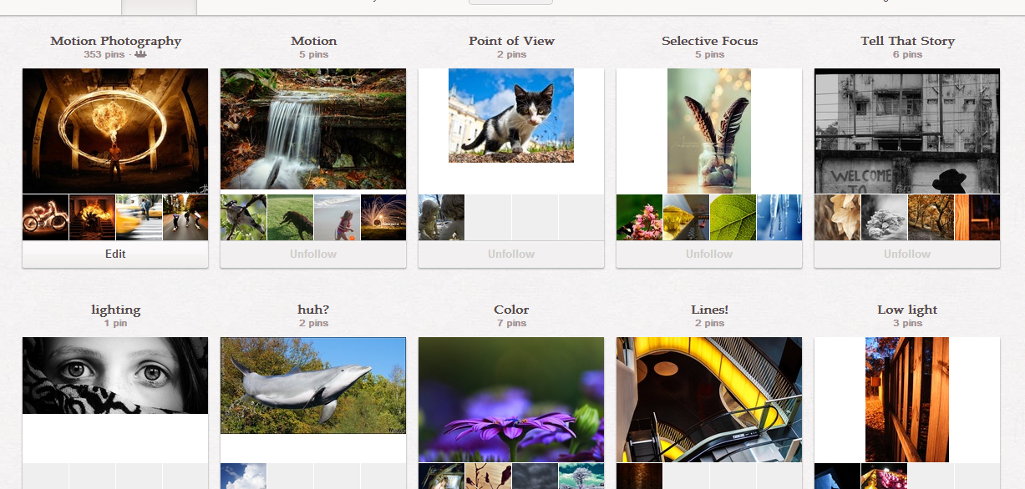
“Pinning It” as Visual Research
Photography student’s Pinterest page documents her visual research

Slide 9
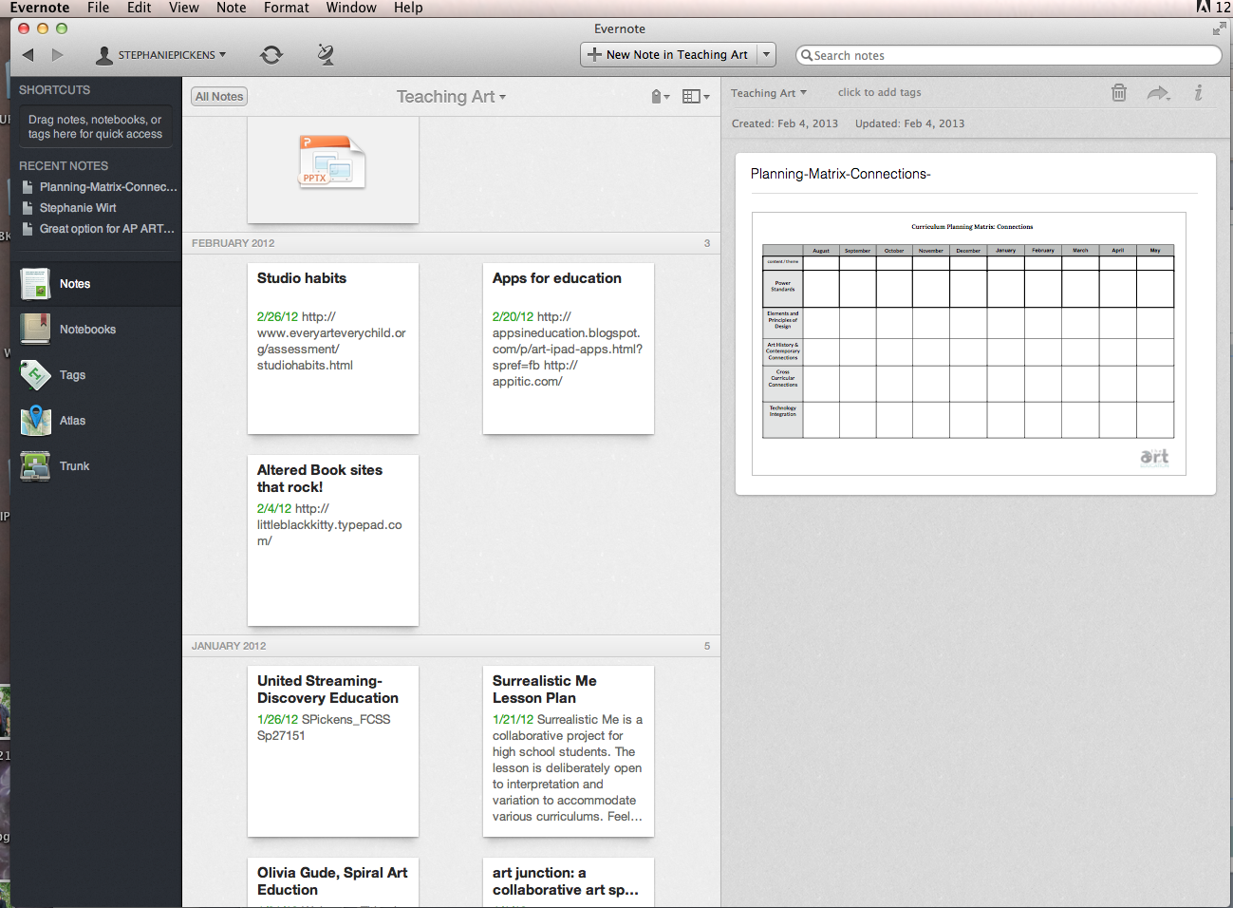
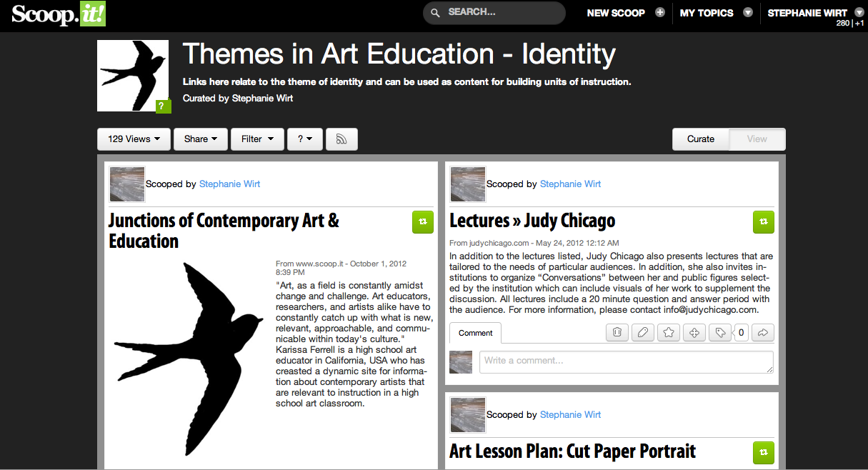
Delicious is Replaceable
Similar to Pinterest by tagging links, but not visual
Website less and less user friendly, dated website
Evernote (with Webclipper) impressive option, better looking and more friendly
Pinterest is visual tagging therefore more attractive to visual people like artist, art teachers and students
ScoopIt allows uses to users to curate websites and organize them into subject groups

Slide 10
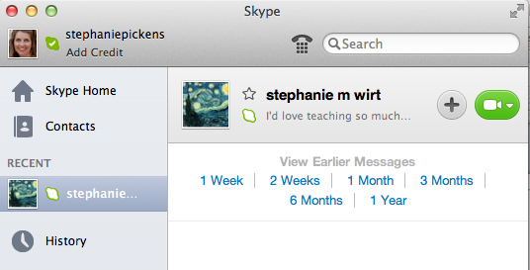
PLNs Lead to Collaboration
Collaborative Photography Project Brings It all Together
Merging traditional and contemporary art making processes
Utilizing Pinterest, Drop Box, Email, Flicker, Video, Skype (teacher planning)
Teaching effective “appropriation“, collaboration and documentation
Teaching ethical habits with contacting other artists when using their images
Annotating rather than copy/paste for Pinterest descriptions
Crediting original photographer
Creating beautiful works of art
Developing social skills, making professional connections, and growth in proper media practice

Slide 11
PLNs Inspired a Collaboration Between our Classrooms
Theme = Surrealistic Interpretation of Time
Research Surrealism, Altered Photography, Time (Pinterest)
Upload images to teacher websites/choose images to work with. (Combining B&W Film Images with Color Digital Images)
Make contact with student photographers
Combine Images
Critiques between states
Web Publishing

Slide 12
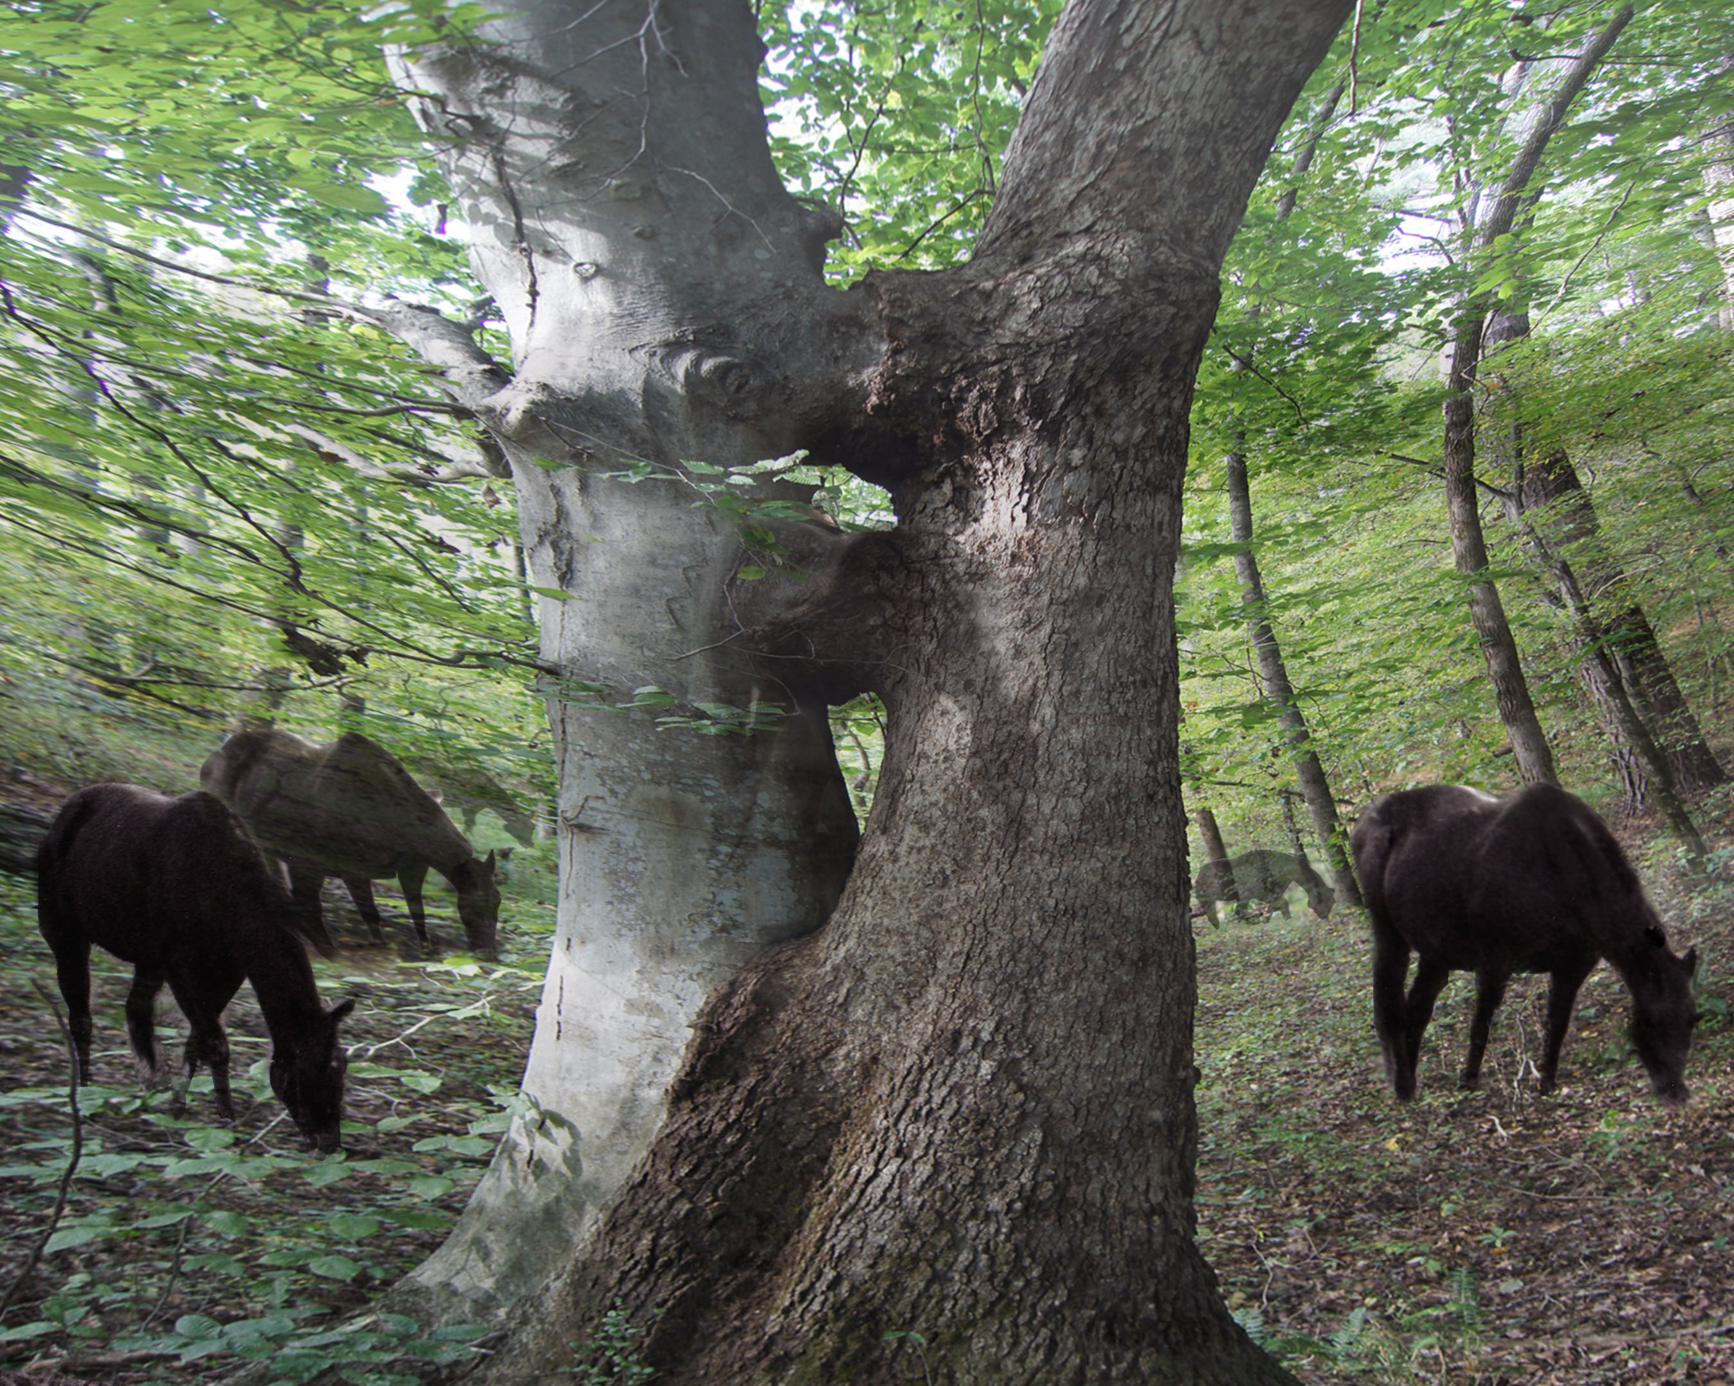
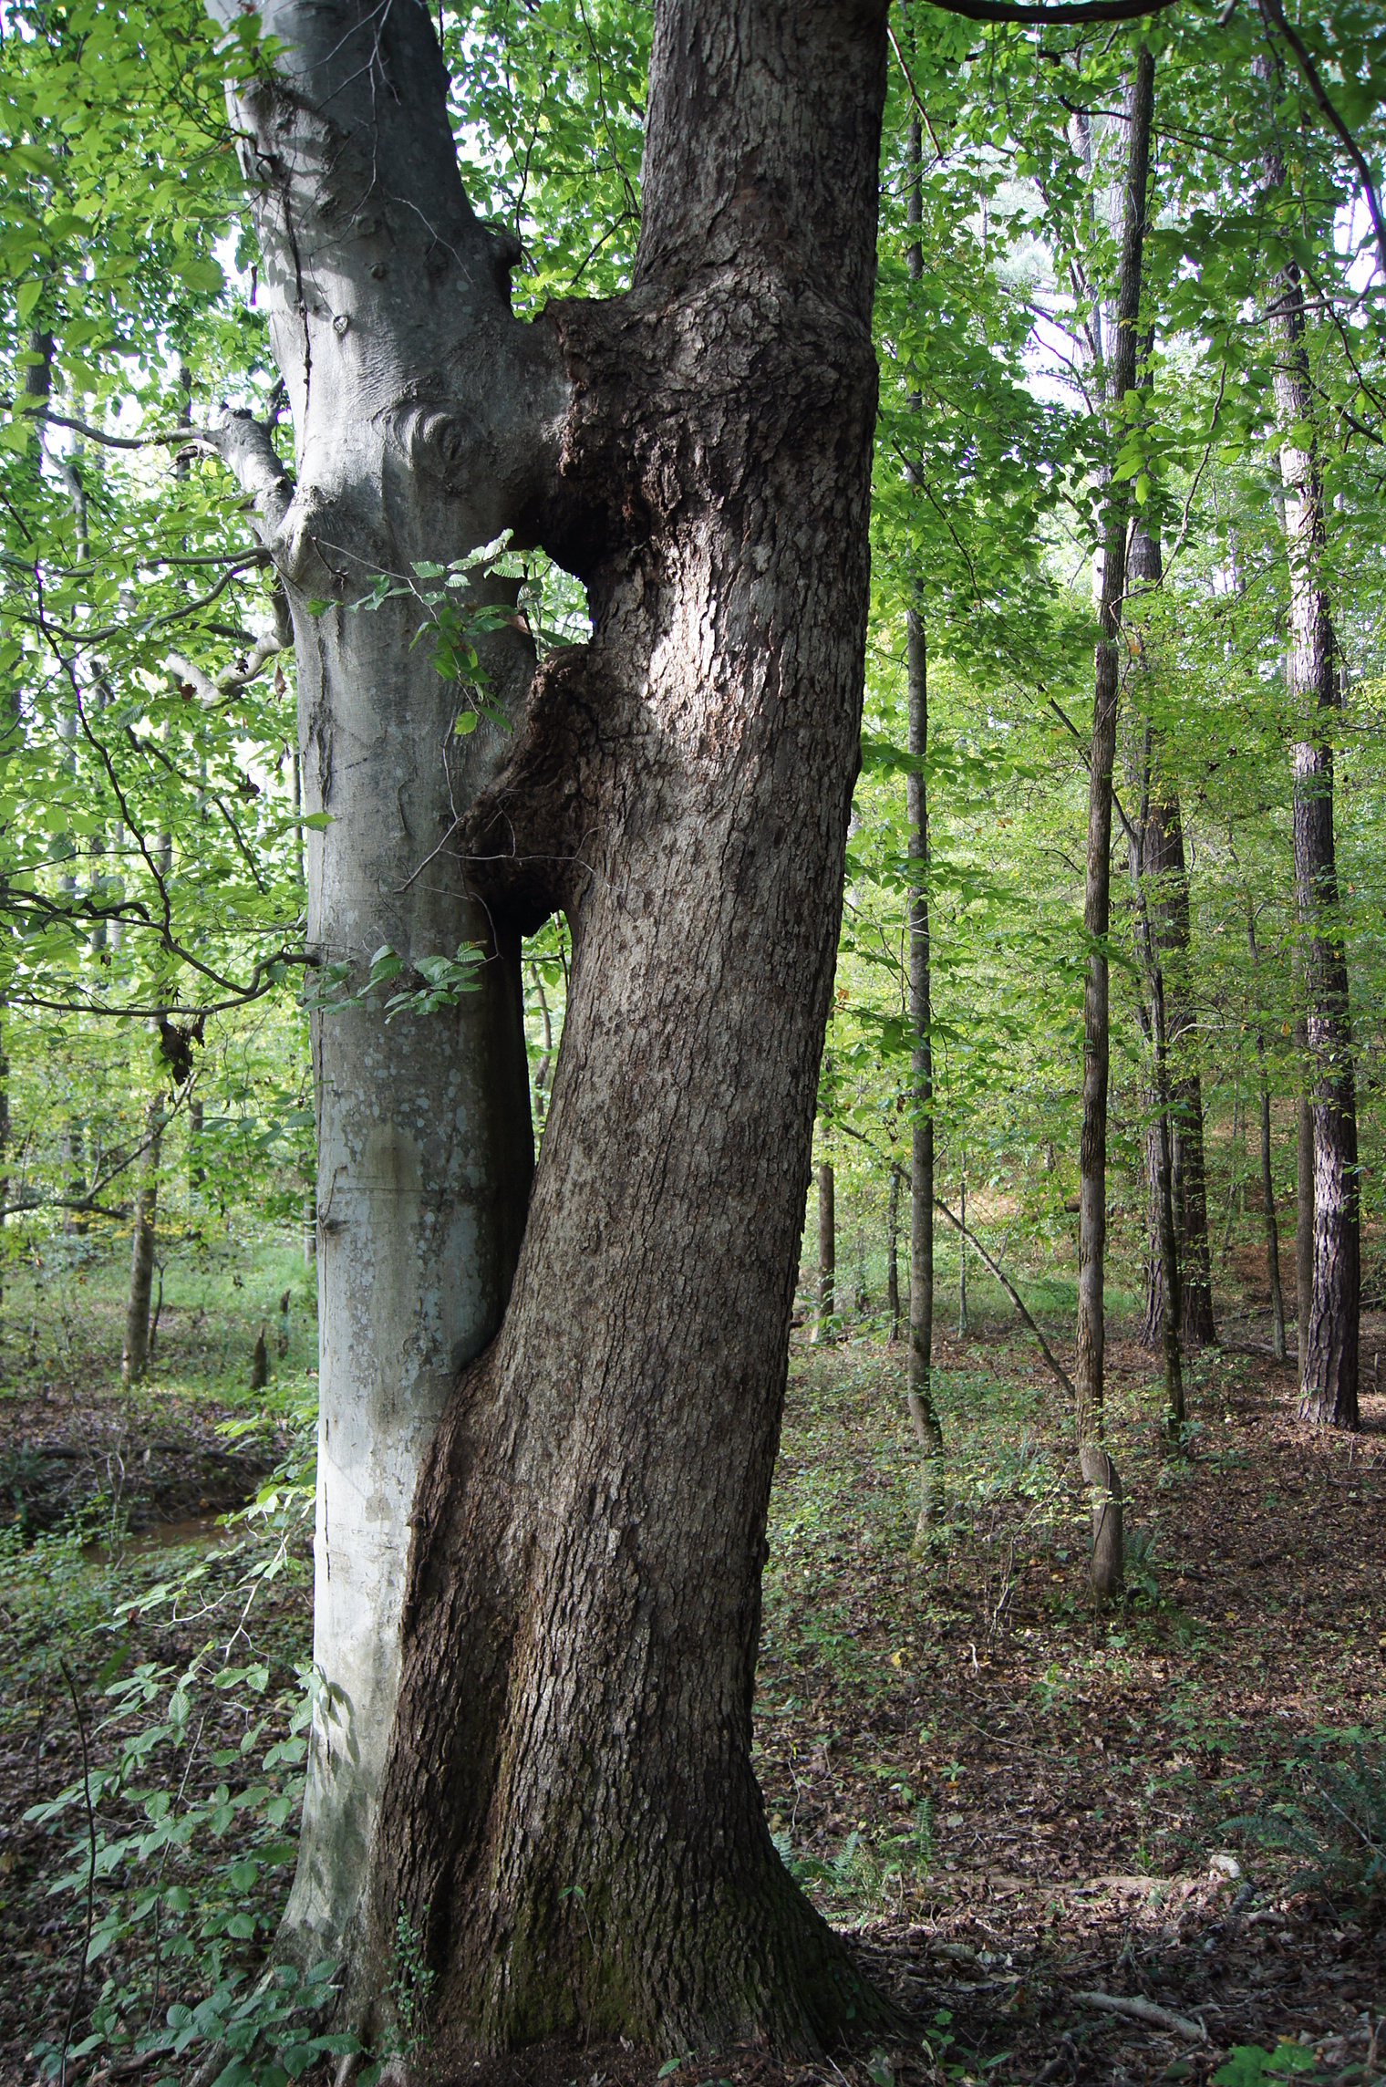
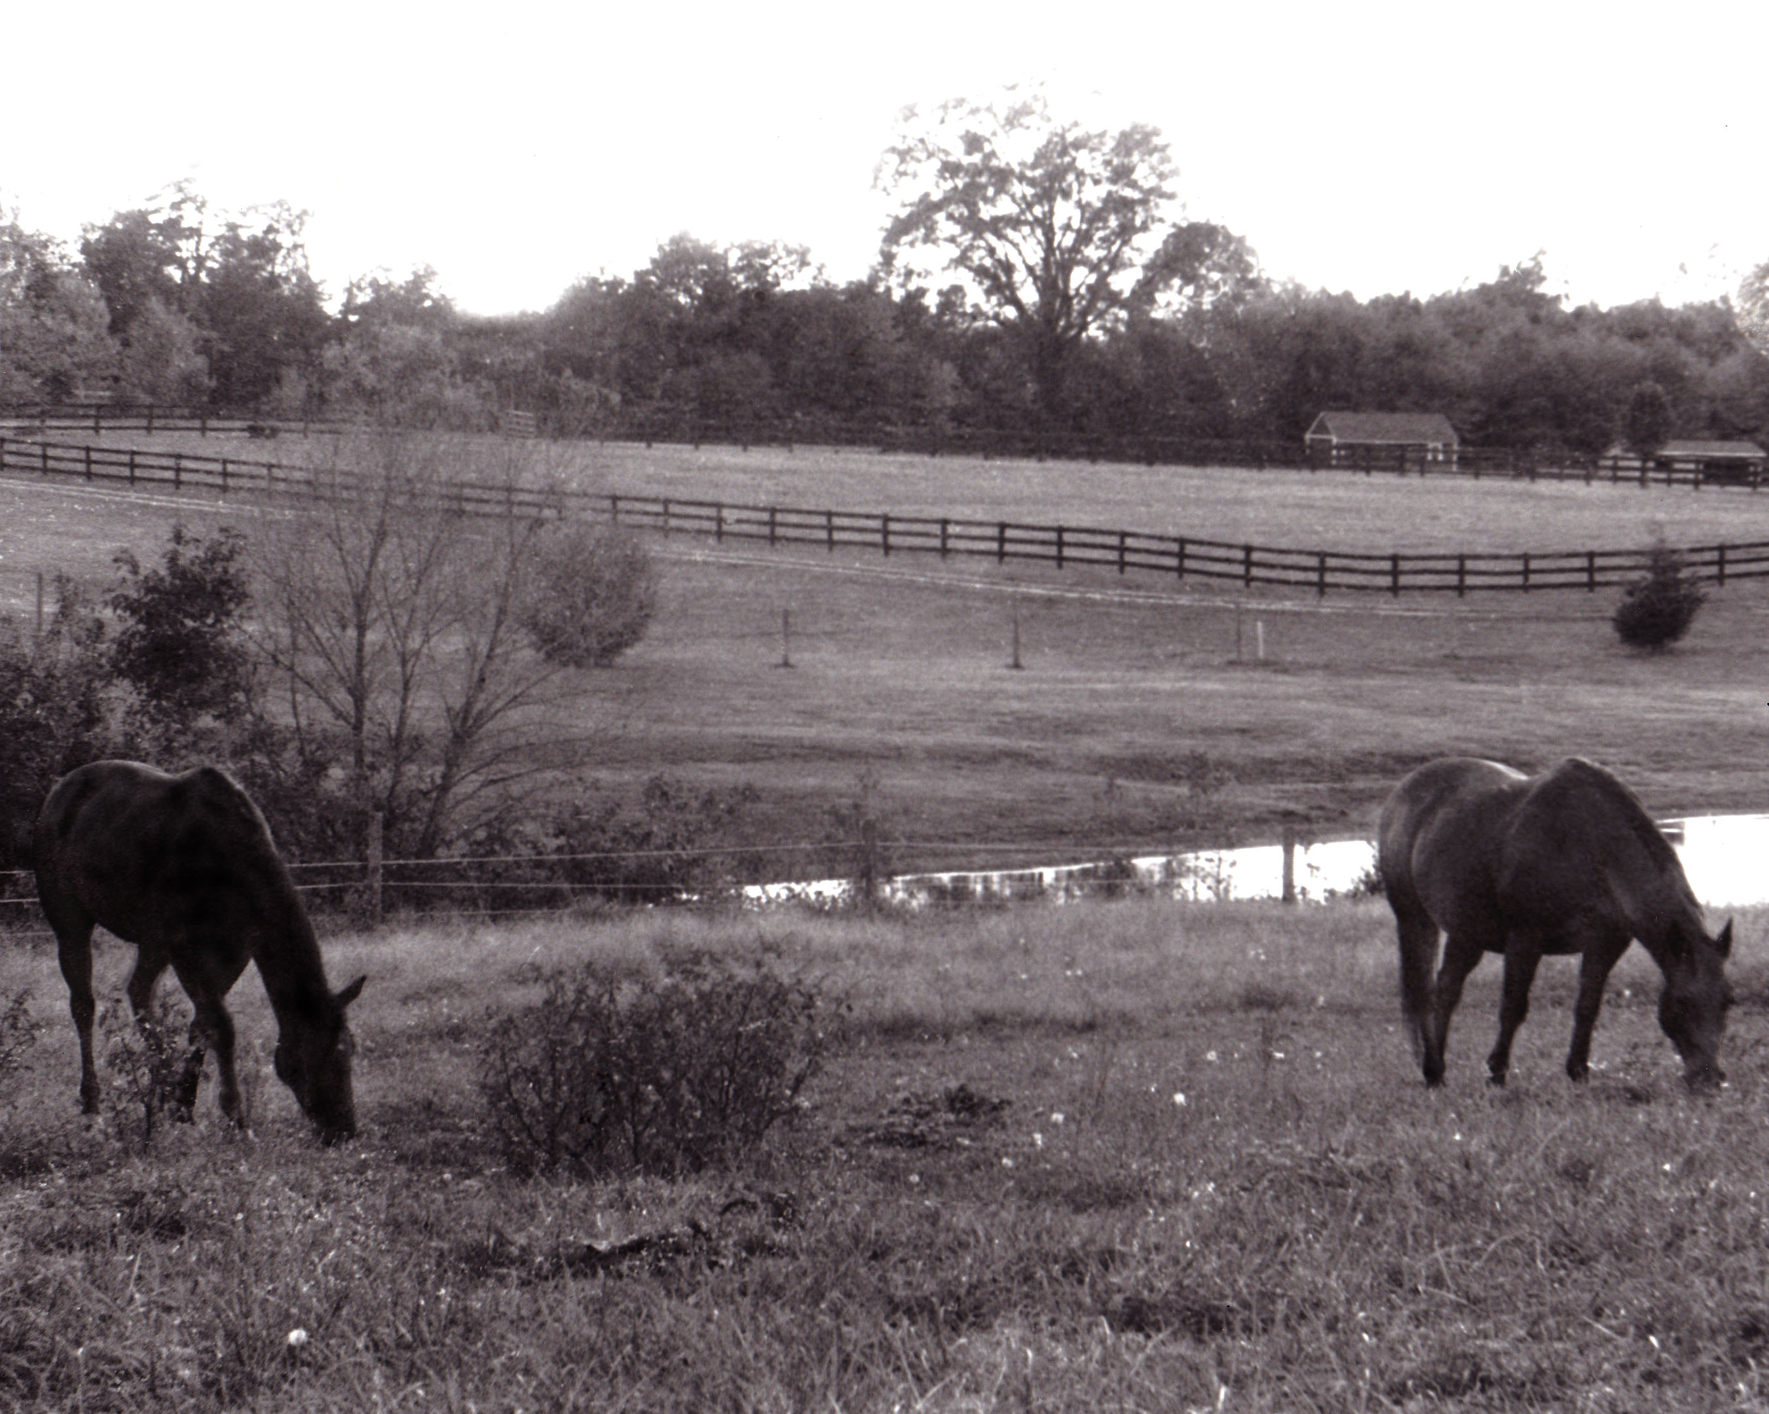
Surrealistic Interpretation of Time
1. Instruction & Discussion about “Time”
4. Contact Student photographers
5. Combine and Create
2. Research
3. Select Images
6. Critique & Communicate
7. Fine Tune and Complete
8. Reflect and Publish
Tree Image by Serena Spence (Pickens) - Horses by Kathryn D. (Wirt)

Slide 13
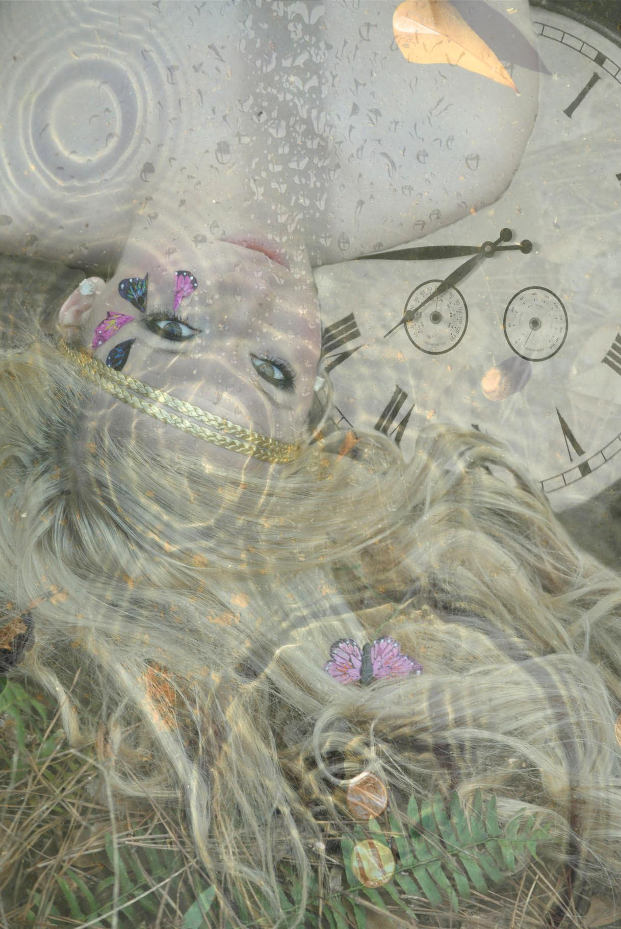
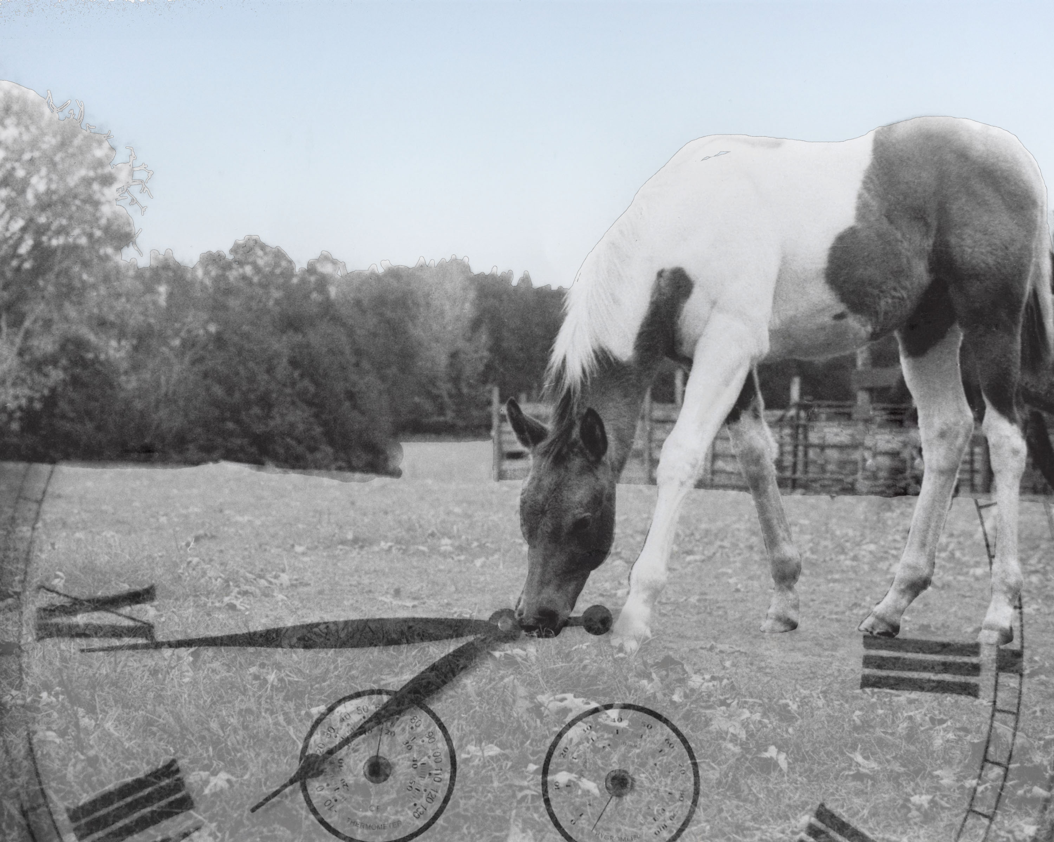
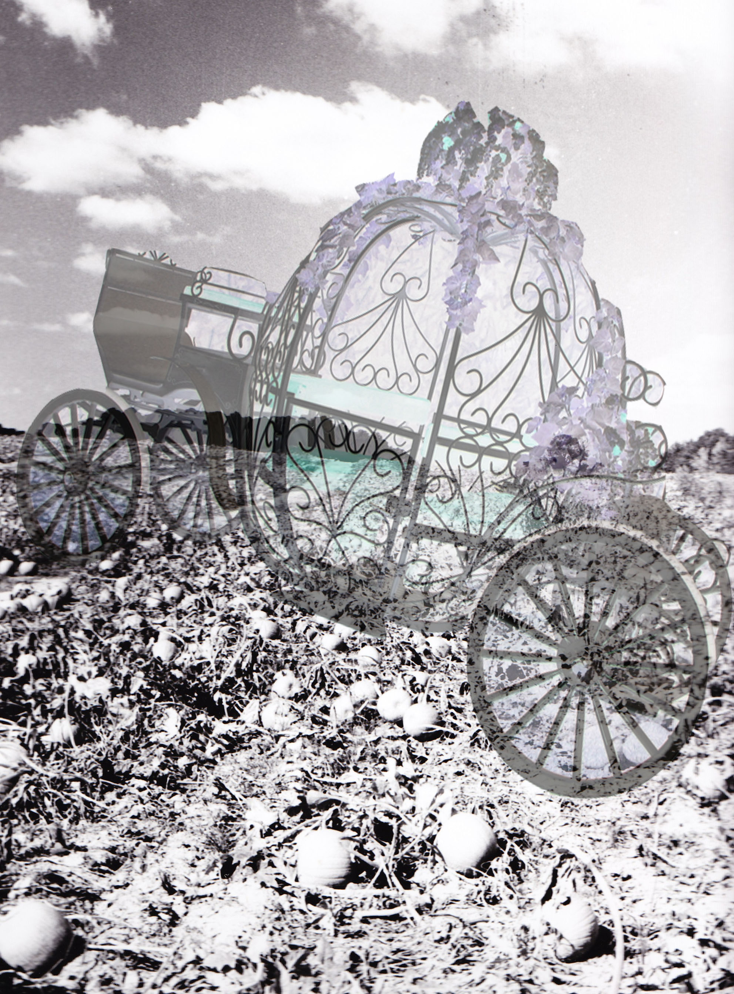
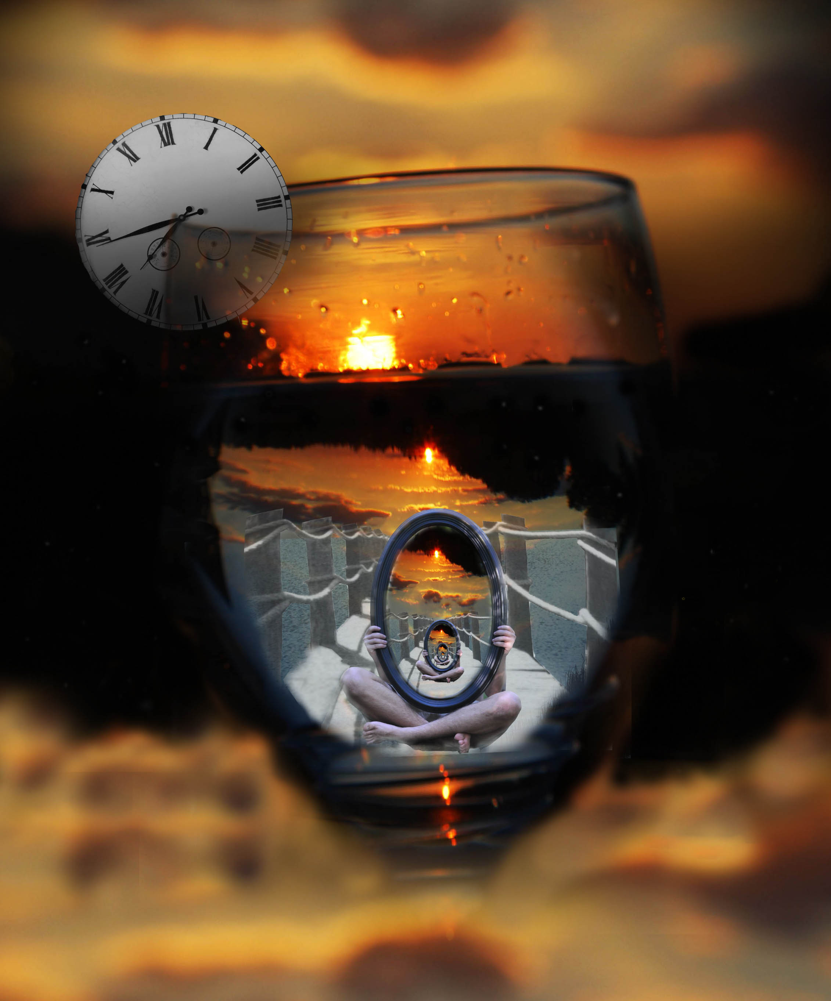
Surrealistic Interpretation of Time

Slide 14
What are the benefits of collaboration?
21st Century Skills
Innovative Technological Concepts
Development of Creativity
Building personal and professional connections
Social and artistic growth

Slide 15
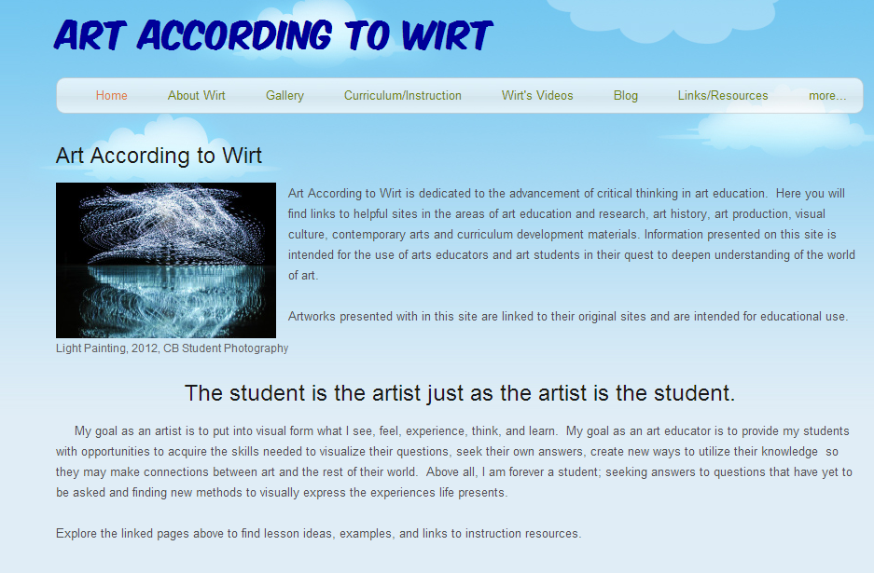
Contact us for more information about PLNs
Stephanie Wirt
Wirtartalk.org
Stephanie Pickens
Stephaniepickens.com
stephanie@wirtartalk.org
stephaniepickens@me.com

Slide 16
Great Art Education Innovators to Follow
ScoopIt, Twitter, Faebook, Pinterest Boards, Blogs and More
Junctions of Contemporary Art & Education
21st Century Art Education
New Media Art Education & Research
Technology in Art And Education
Ceramics and Sculpture-New Techniques
Photography Tips & Ideas
ArtSite Blog - Teaching and Learning through Art
Best iPad Apps for Art Education, 2012
3D Virtual Worlds: Educational Technology
Voices in the Feminine
Art Education on Twitter
http://pinterest.com/edelacruz/
http://pinterest.com/wirtart/
http://pinterest.com/stepickens/art-ed/
UFGlobal on Pinterest
Facebook-Art Teachers
http://paper.li/emdela/1360728991
The Art of Ed
Art is Fun
Art Junction by Craig Roland
Spiral Art Education by Olivia Gude
Online Artists Sketchbooks
Khan Academy of Art

