Slide 1
Pinning your Flickr is Delicious
Professional Learning Networks in the high school setting.
How can utilizing digital and web technologies enhance instruction and student learning in the arts?
Stephanie Wirt
Powhatan High School • Powhatan, Virginia
Stephanie Pickens
West Forsyth High School • Cumming, Georgia

Slide 2
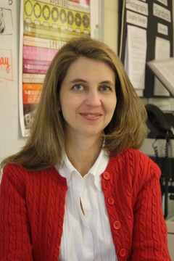
Contact us for more information about PLNs
Stephanie Wirt
Wirtartalk.org
Stephanie Pickens
Stephaniepickens.com
stephanie@wirtartalk.org
stephaniepickens@me.com

Slide 3
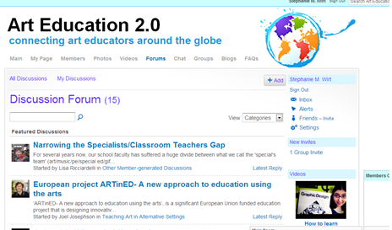
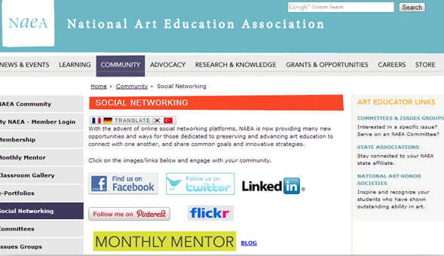
What’s a PLN?
Personal Learning Network

Slide 4
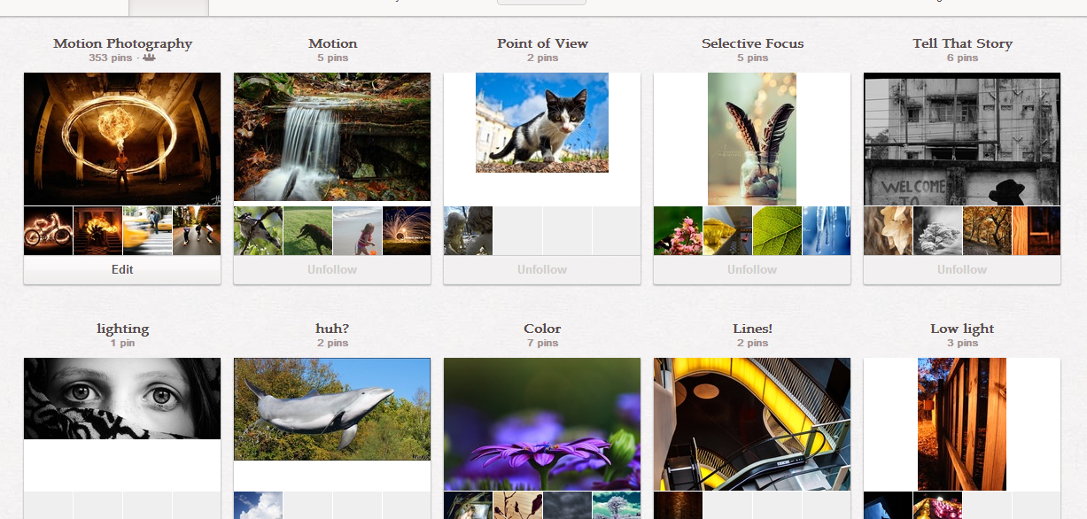
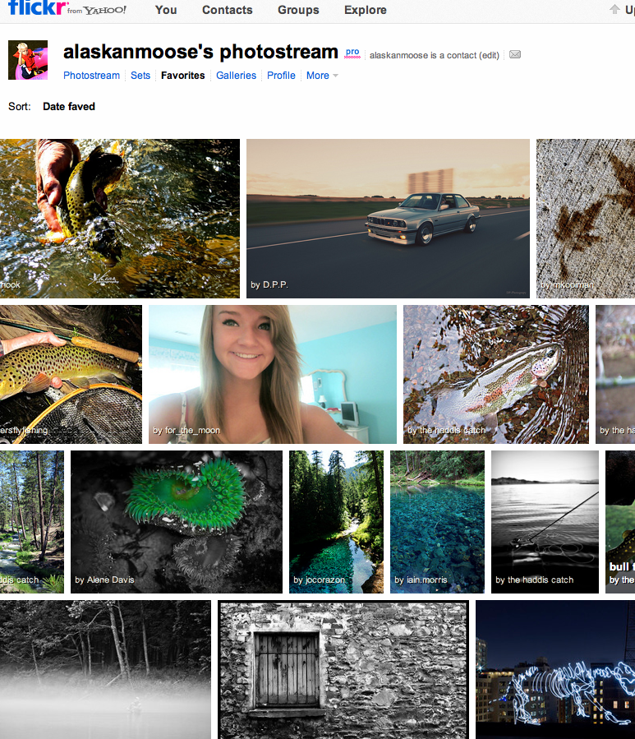
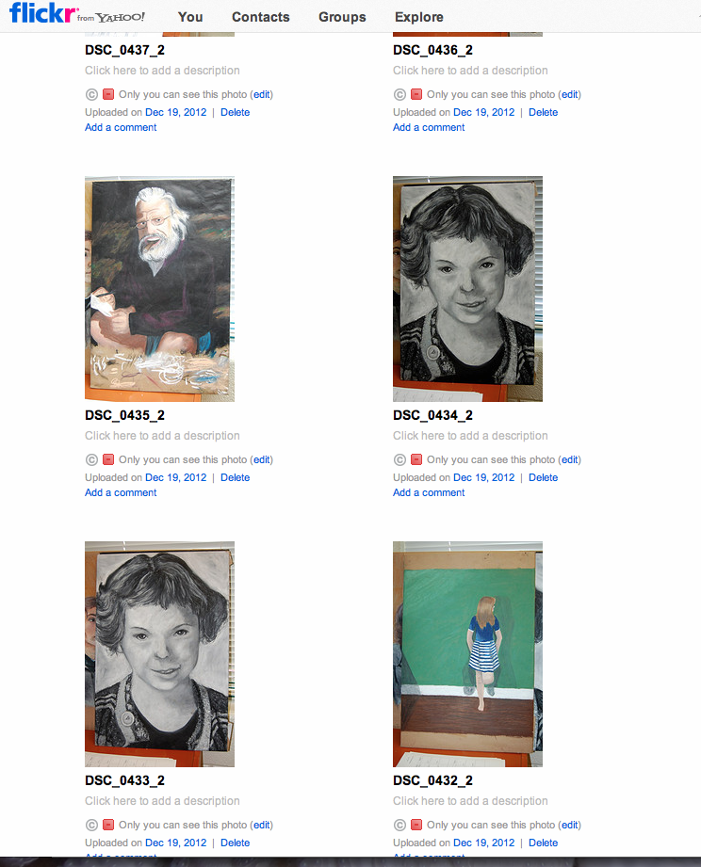
Pinning and Flickr as Visual Research
Pinterest
Flickr

Slide 5
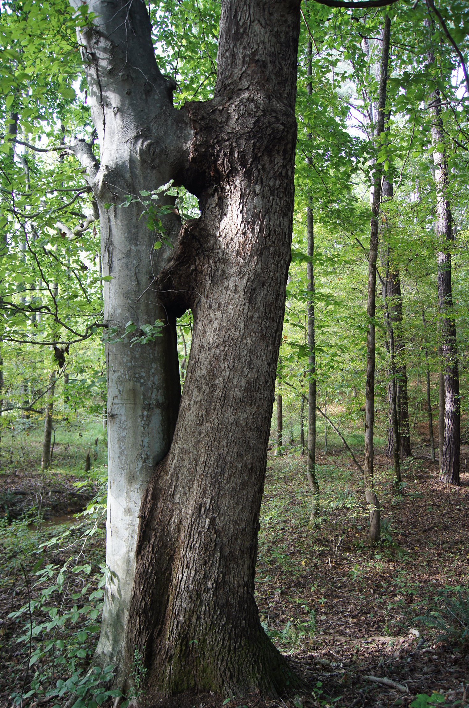
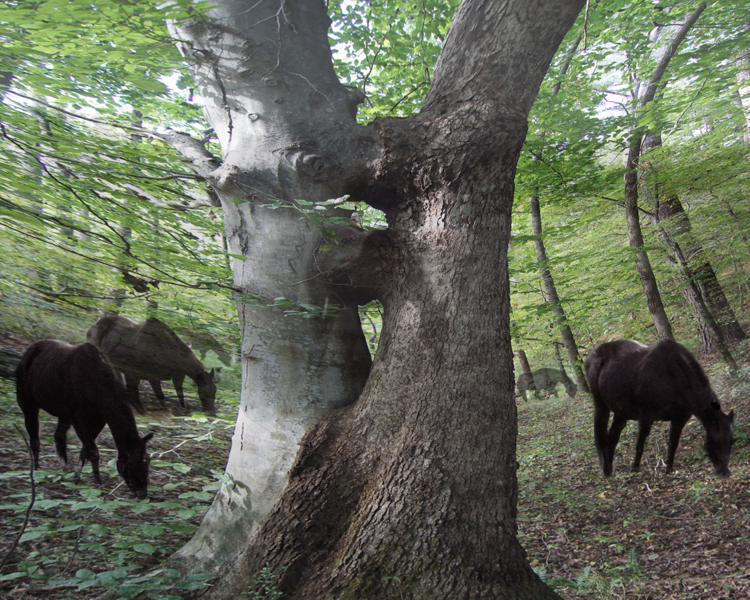
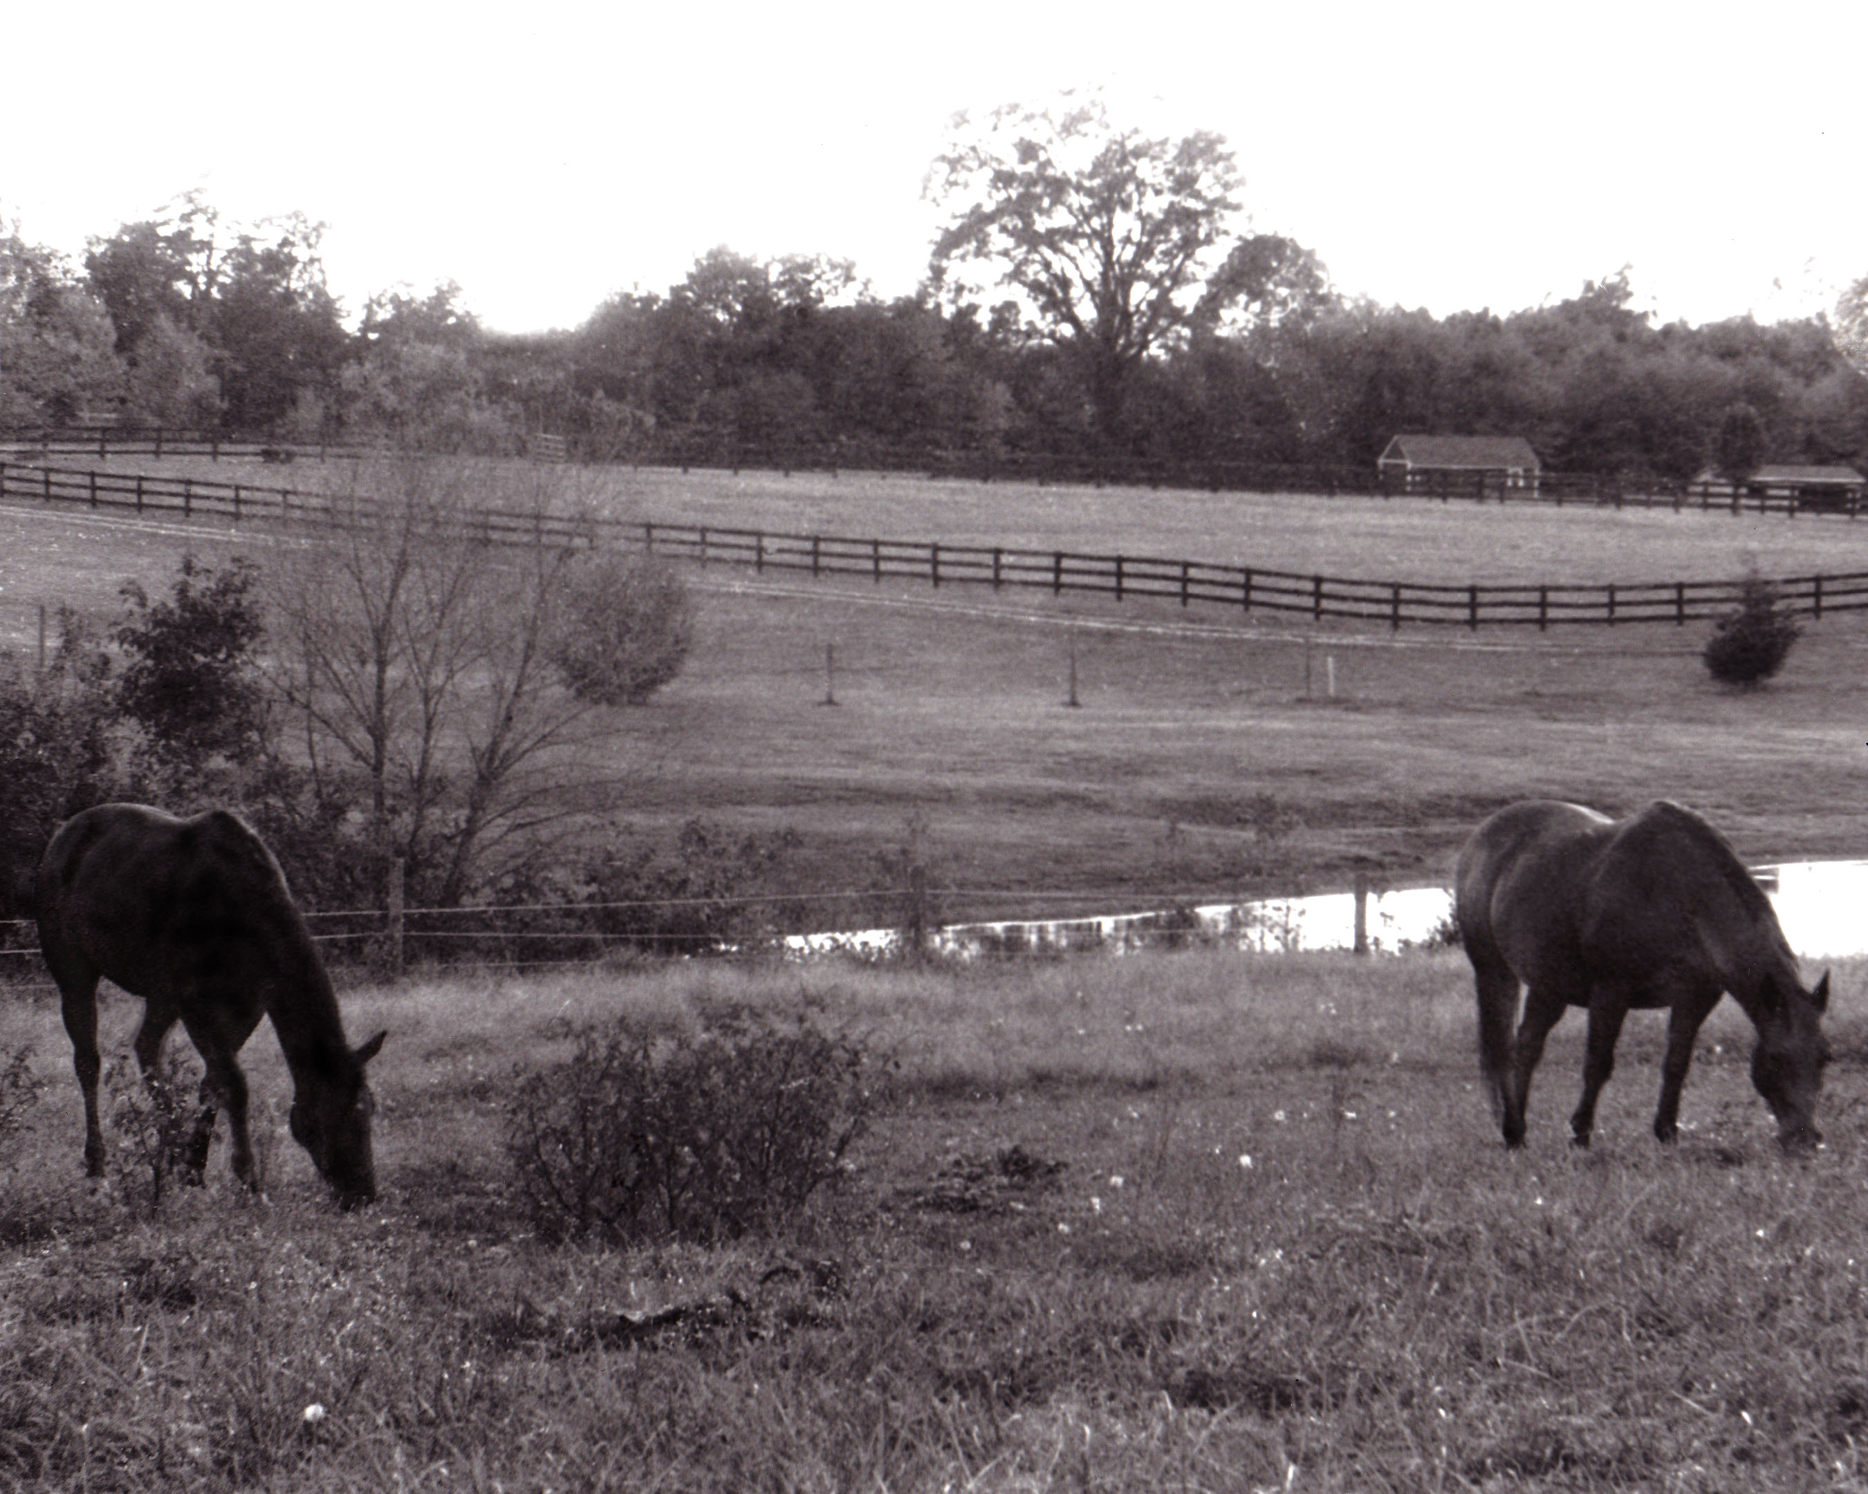
Surrealistic Interpretation of Time
Tree Image by Serena Spence (Pickens) - Horses by Kathryn D. (Wirt)

Slide 6
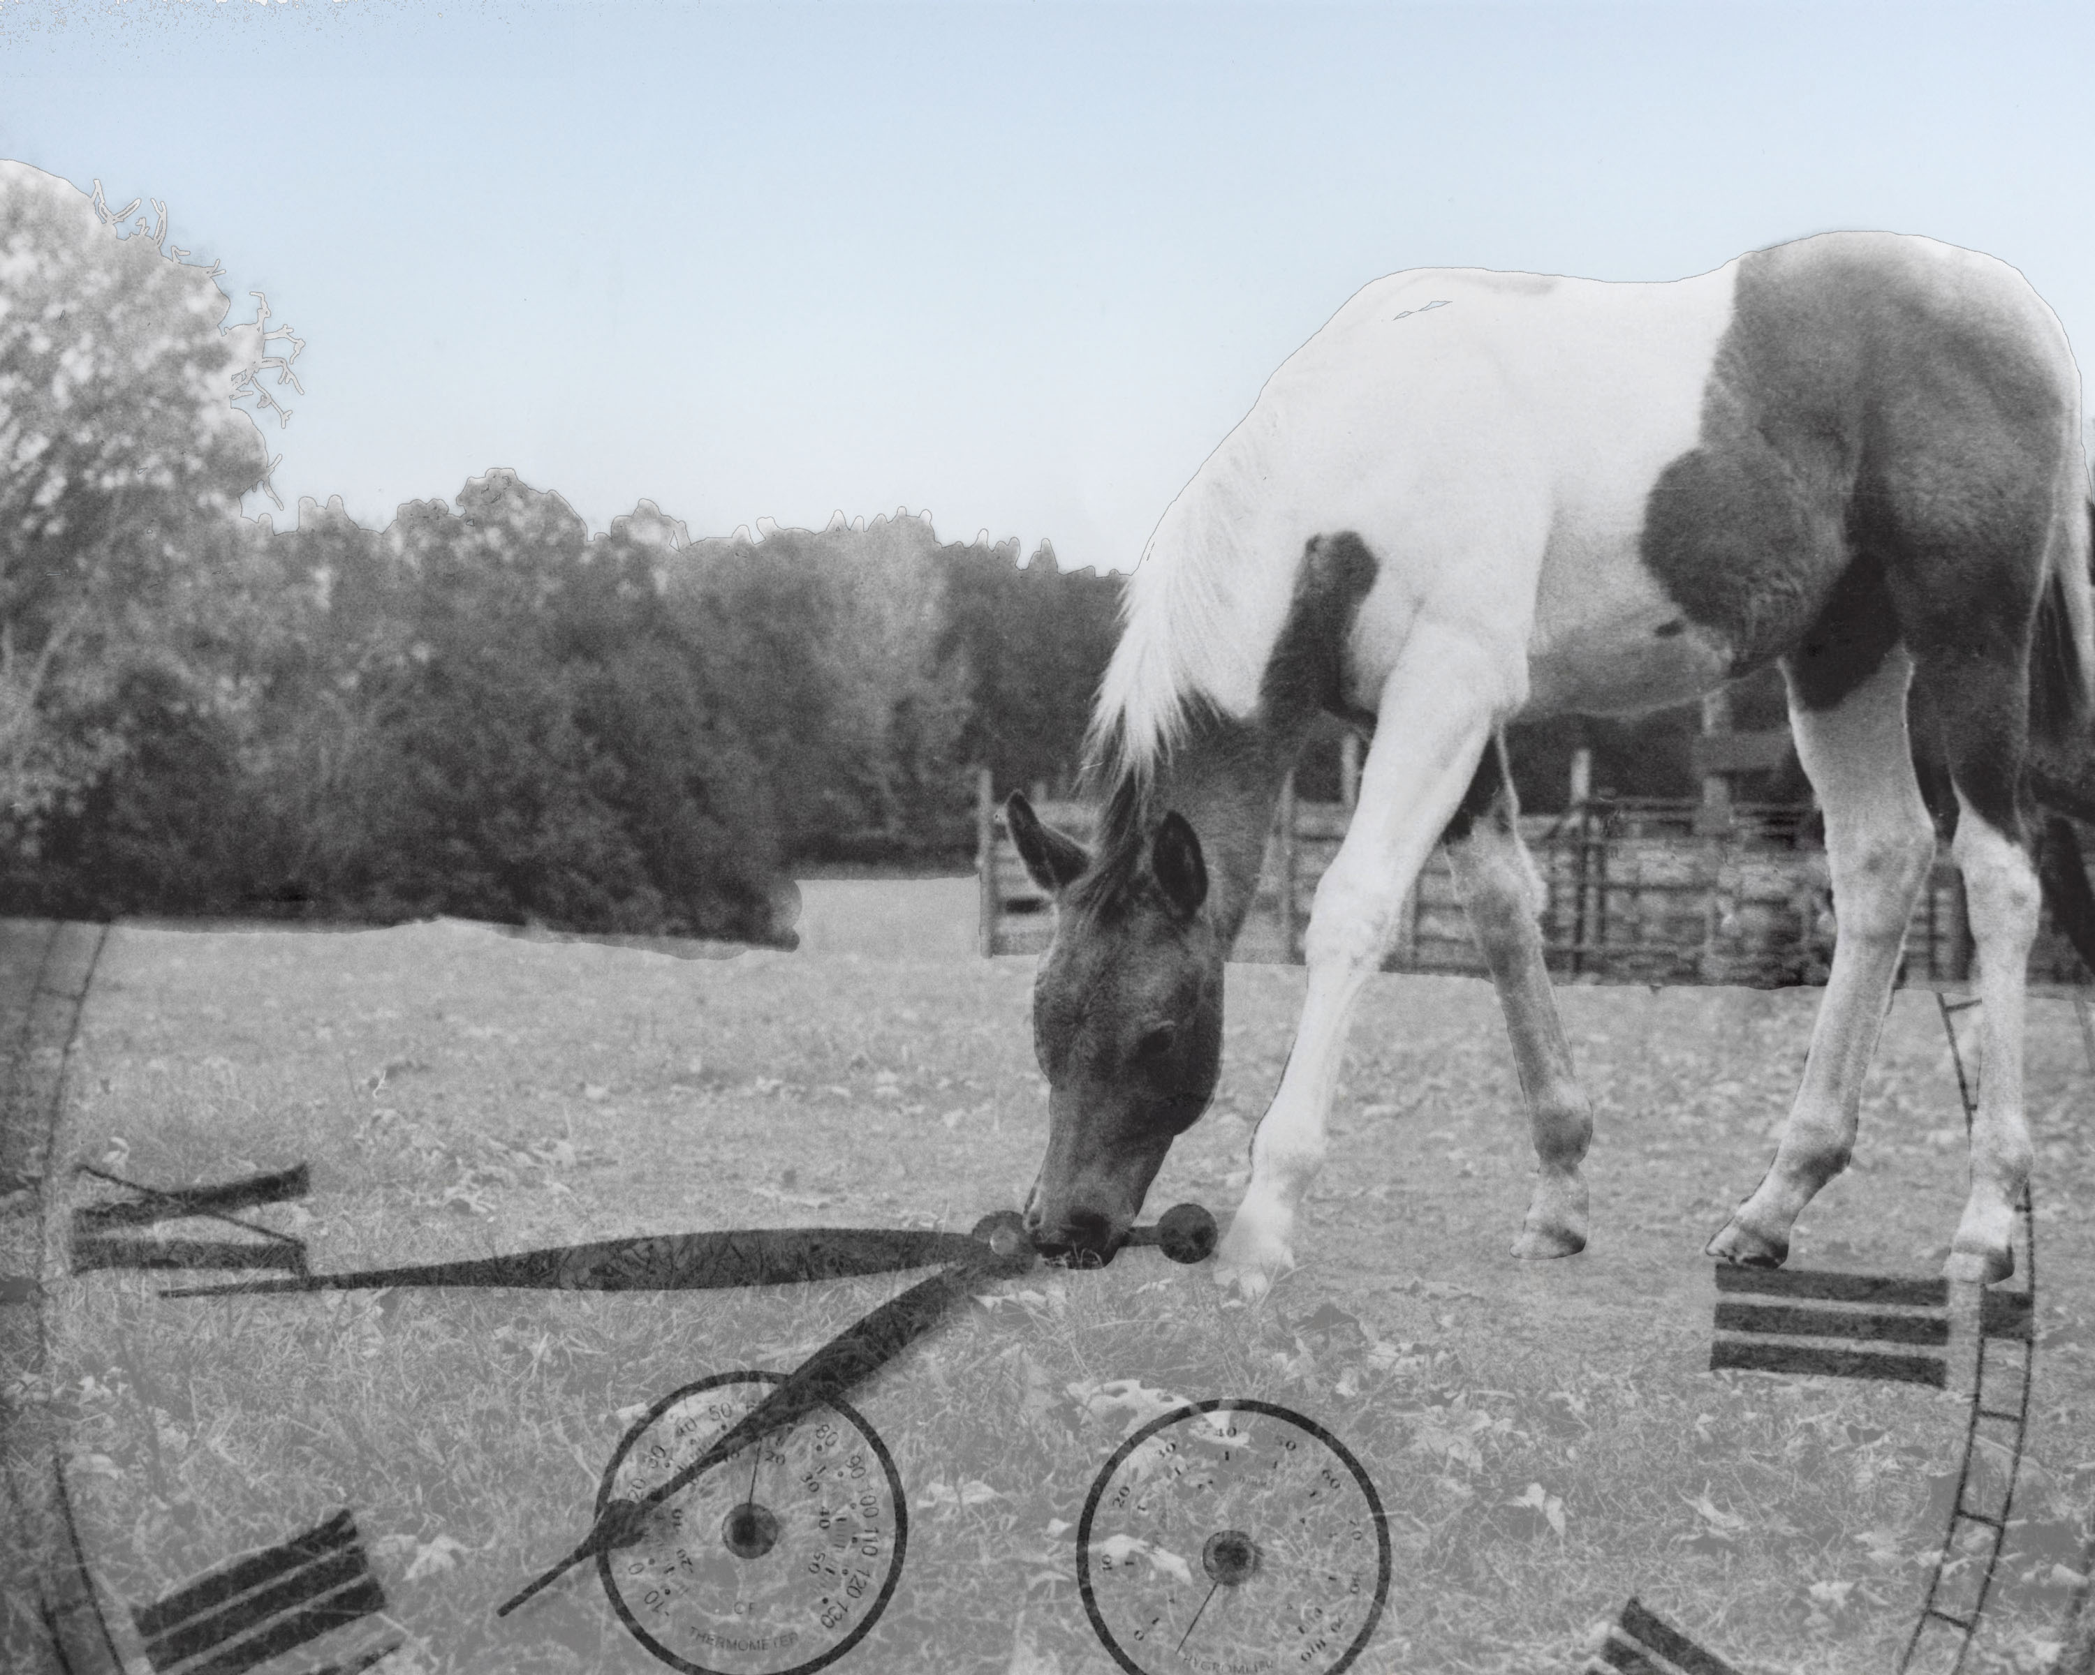
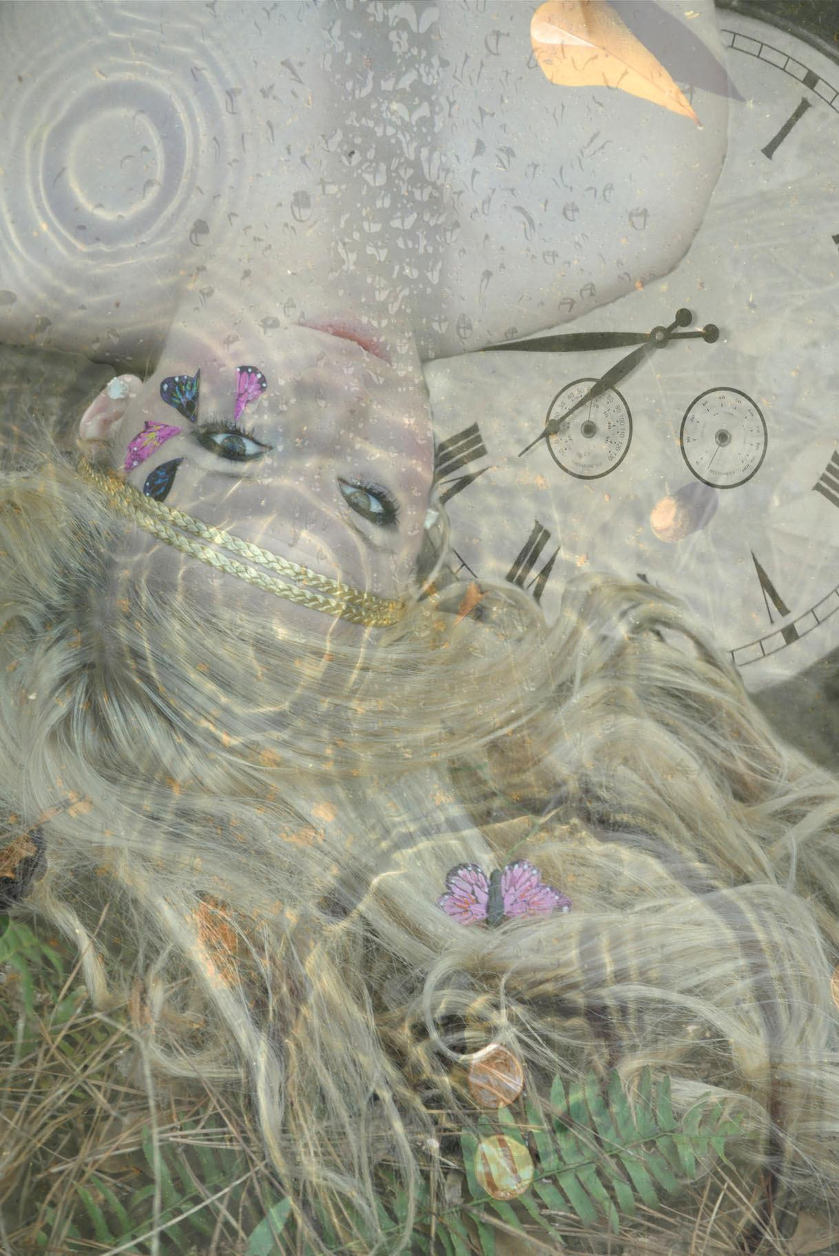
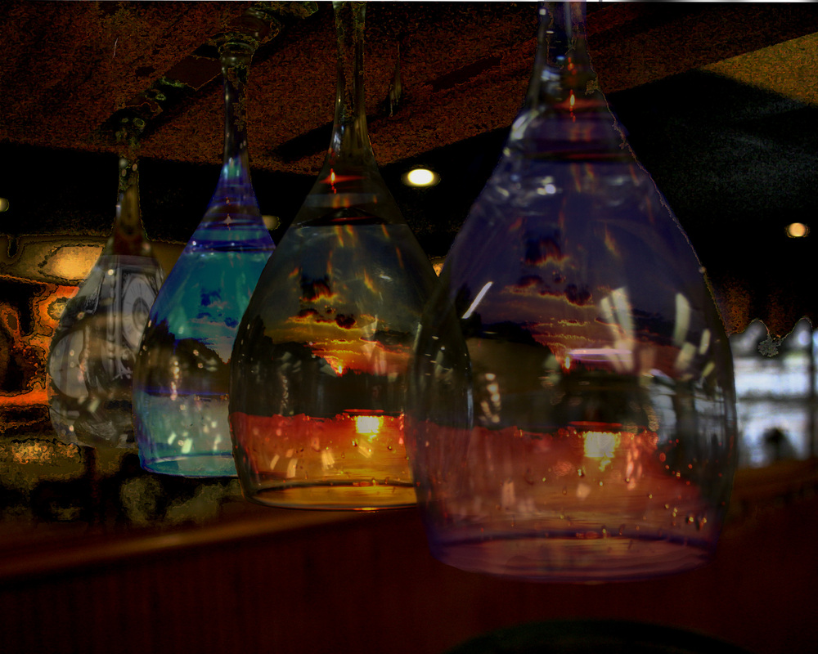
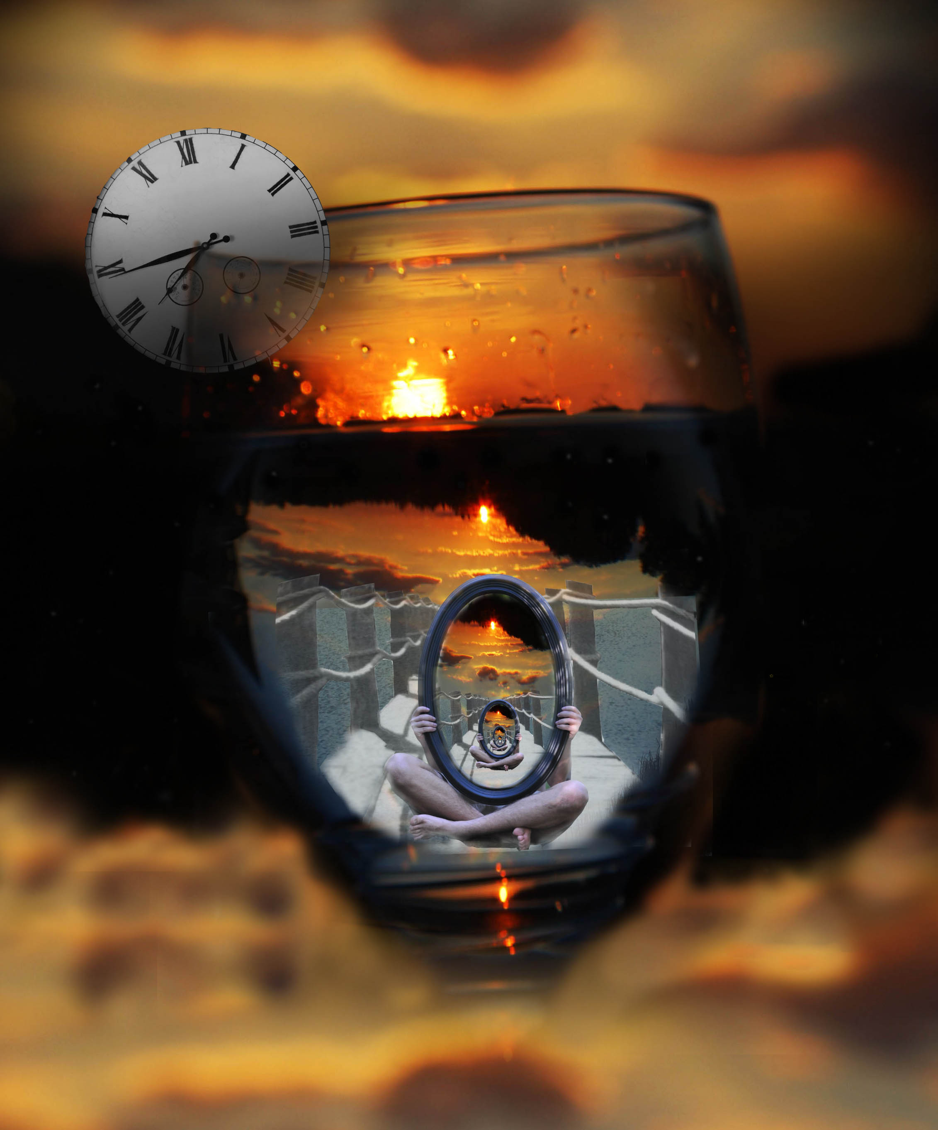
Surrealistic Interpretation of Time

Slide 7
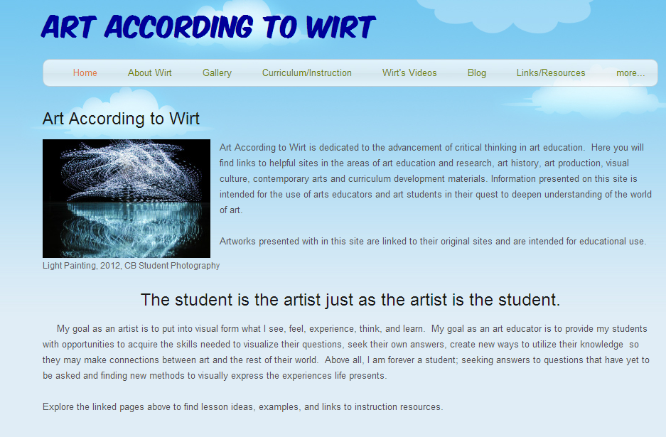
Contact us for more information about PLNs
Stephanie Wirt
Wirtartalk.org
Stephanie Pickens
Stephaniepickens.com
stephanie@wirtartalk.org
stephaniepickens@me.com

