Slide 1
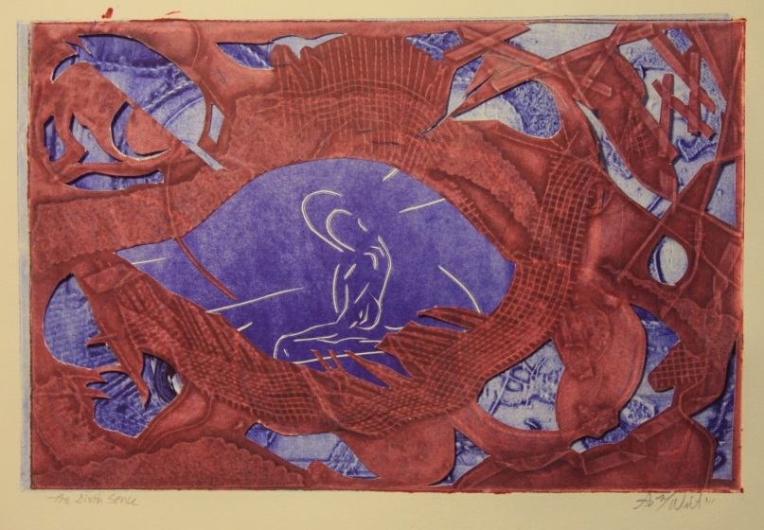
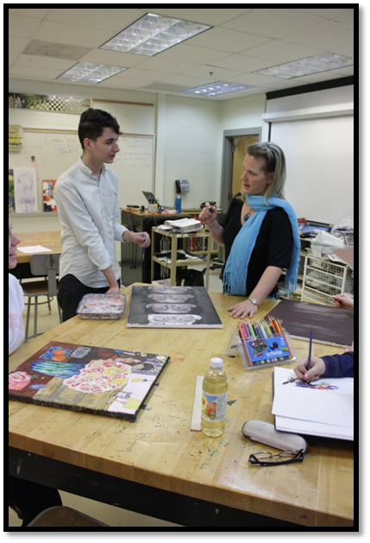
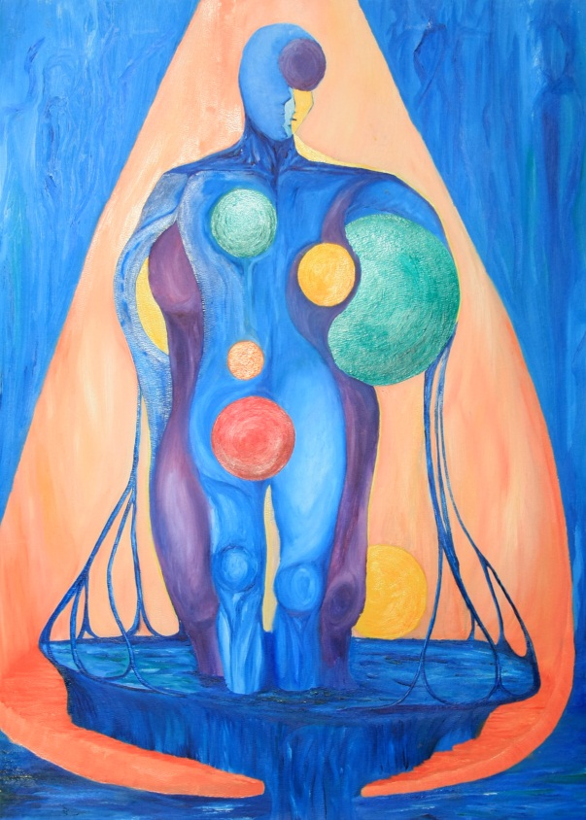
Passion – Principles - Production
Insight – Mixed Media - 2011
She Comes from Water – Oil - 2010
PHS Class Room 2014

Slide 2
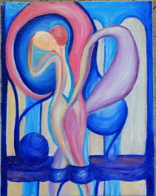
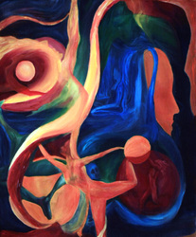
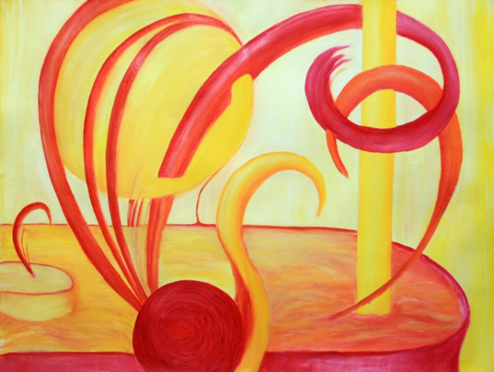
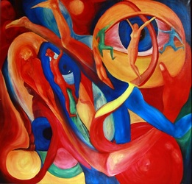
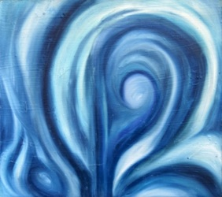
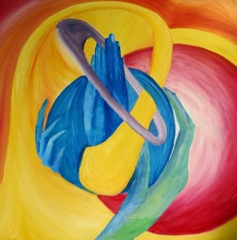
Passion

Slide 3
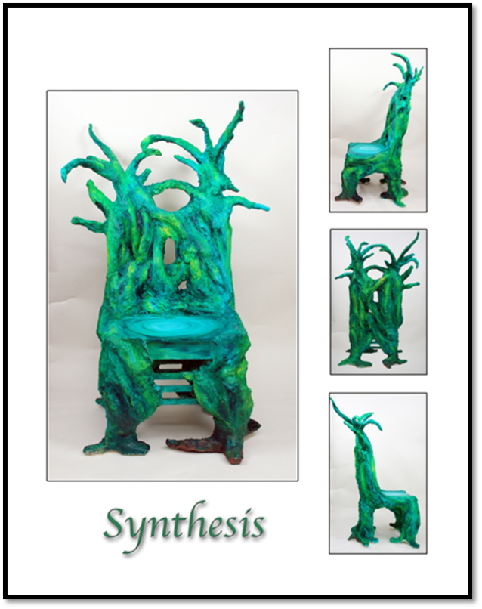
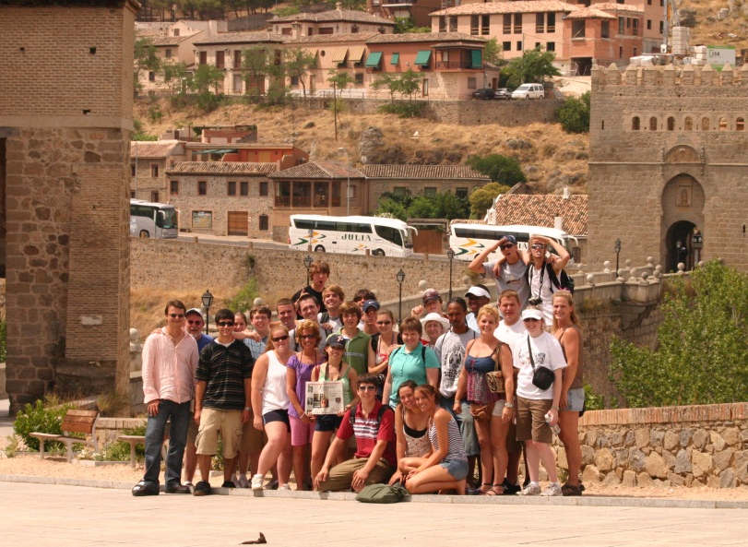
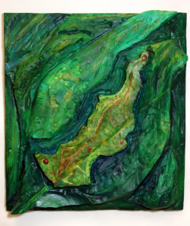
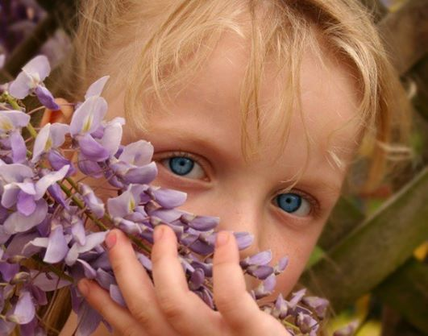
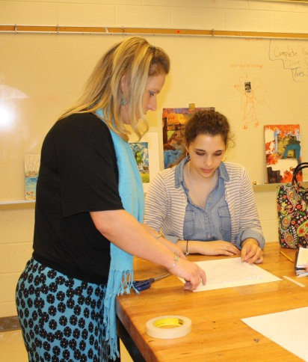
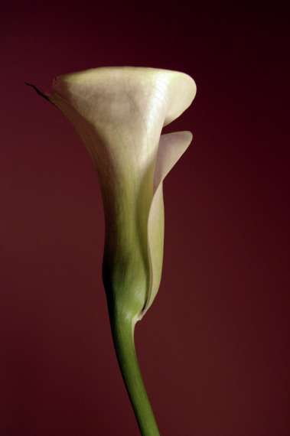

Slide 4
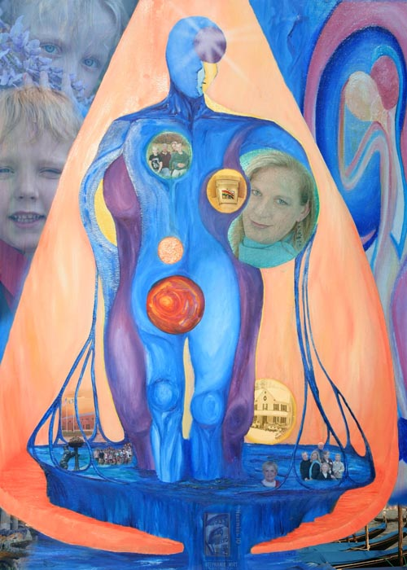
Notes:
If I had to sum it all up in one image it’d be this one. My Family is what supports me and give me strength, my travels open my eyes, my students teach me and my art fuels me.

Slide 5
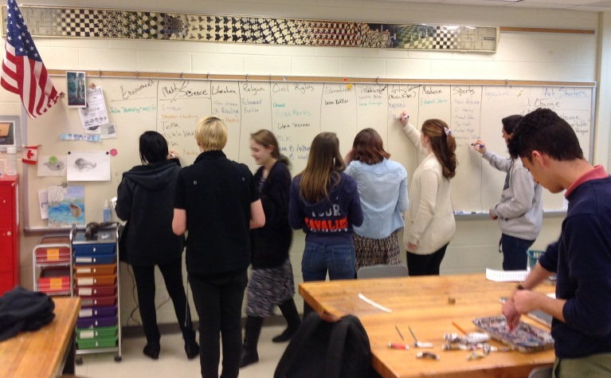
Principles
“Stand up for what you believe in even if you are standing alone”
-Anonymous

Slide 6
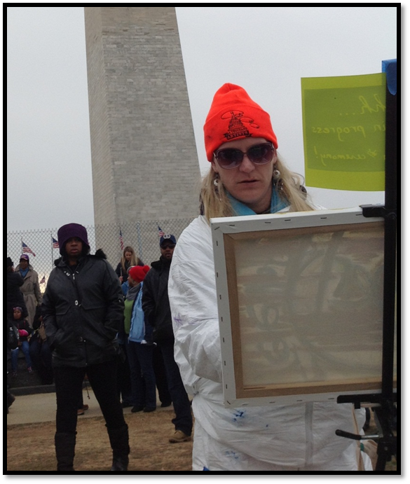
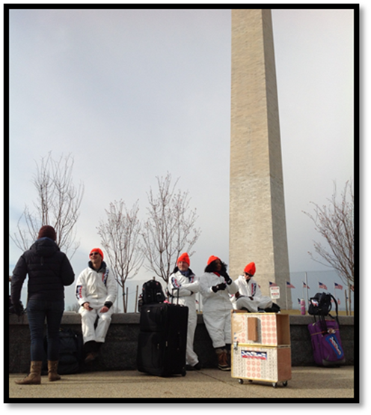
The making of art is the ultimate democracy
A Thousand Artists Inauguration, 2013
Notes:
Thanks to the power of social media and Andrew Purchant I was presented with an oppertunity to put into practice my belief that art has the power in inspire and enlighten the masses

Slide 7
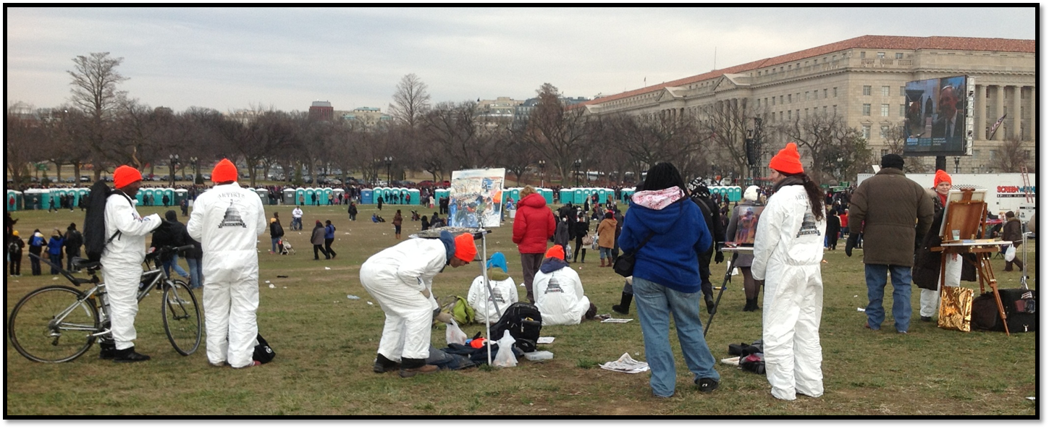
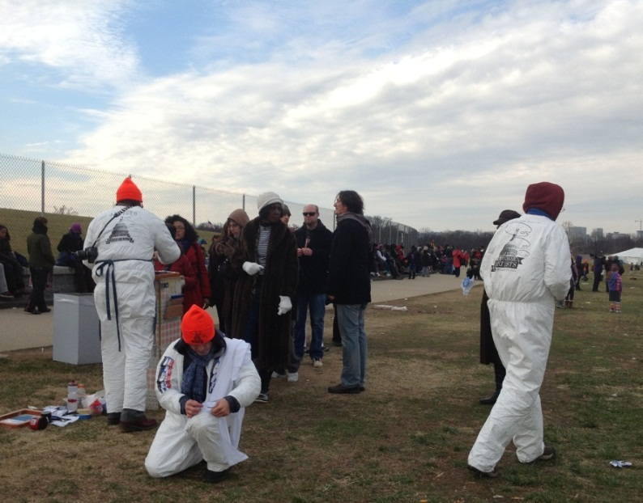
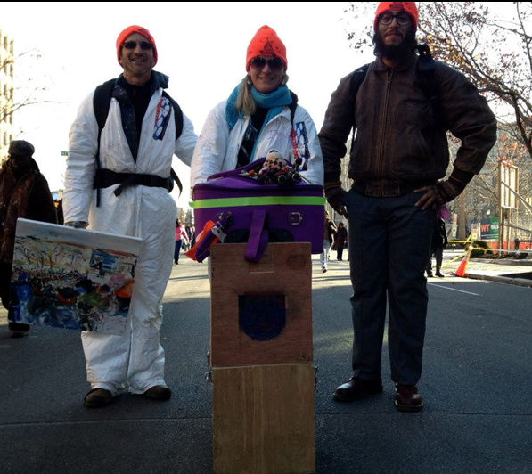
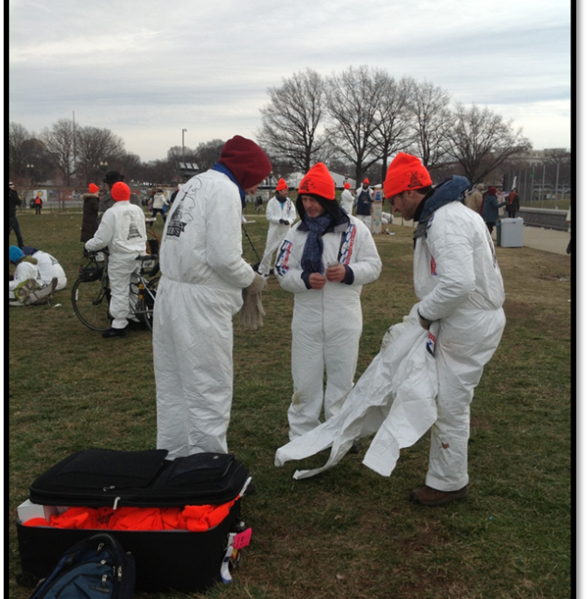

Slide 8
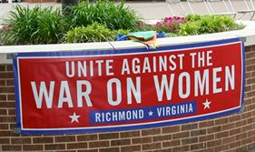
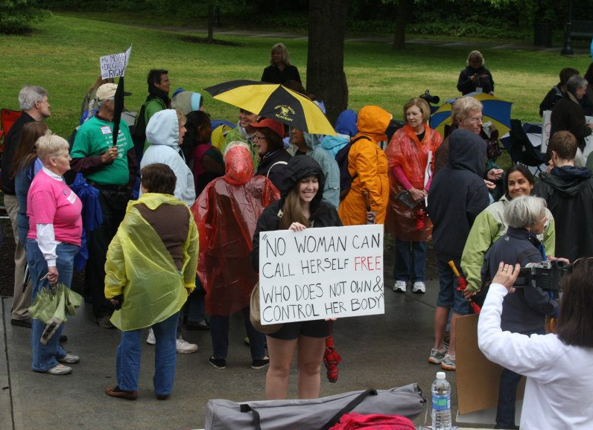
Notes:
My Father told me as a child, “Evil Prospers When Good Men do Nothing” and when my state was creating legislation to limit the contol women have over their own bodies I had to voice my objections.

Slide 9
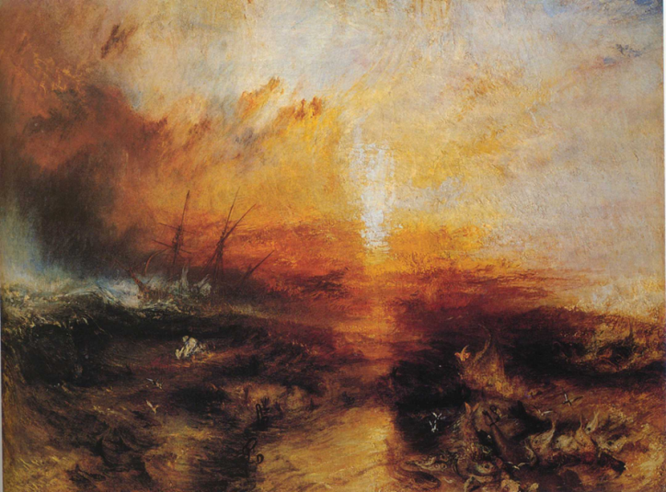
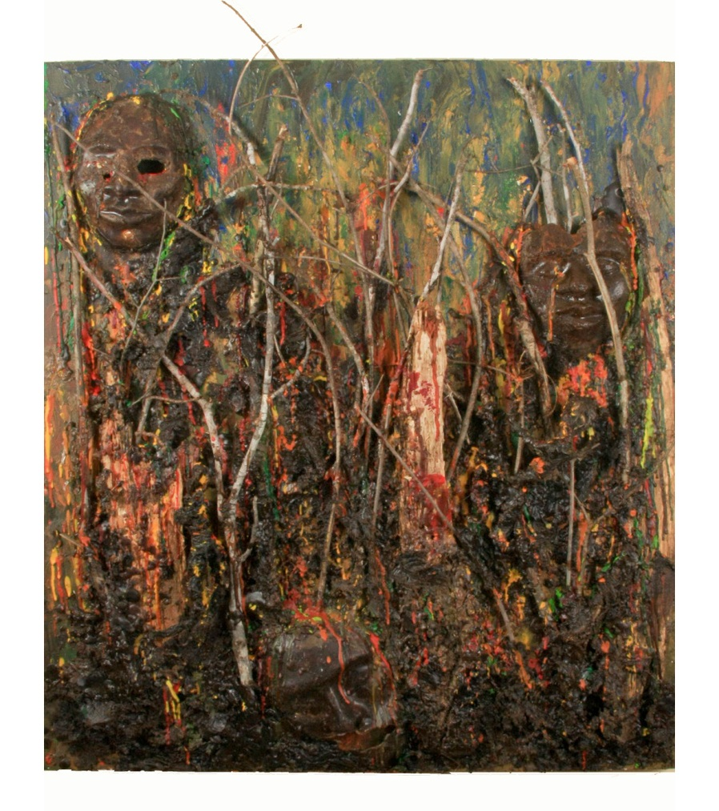
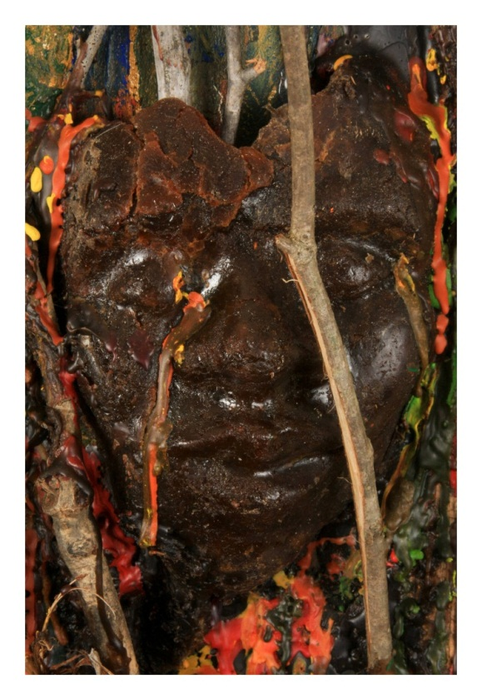
Principles
Slave Ship - William Turner – 1840 - Oil
ChevronToxico – 20”x30” - 2012 - Mixed Media (Wood, Wire, Wax)
Notes:
William Turner once said that ”The artist should not only paint what he sees before him, but also what he sees with in him. If, however, he sees nothing within him, then he should also refrain from painting that which is before him.” He was referencing his painting The Slave Ship which created in his response to a captain of a slave ship in 1783 who threw the sick and dying slaves over board in hopes of collecting on the insurance. This, along with my father’s words have stuck with me. After first reading an article by Patty Bode in Globalization in Art and Education I was inspired to do further research about the destruction in the Amazon created and left by the oil industry which compelled me to create ChevronToxico. This idea of creating visual responses to events is something that is part of my teaching pedagogy.

Slide 10
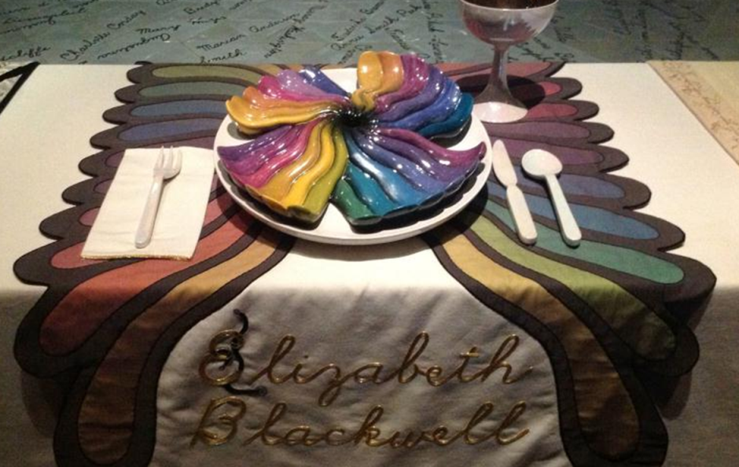
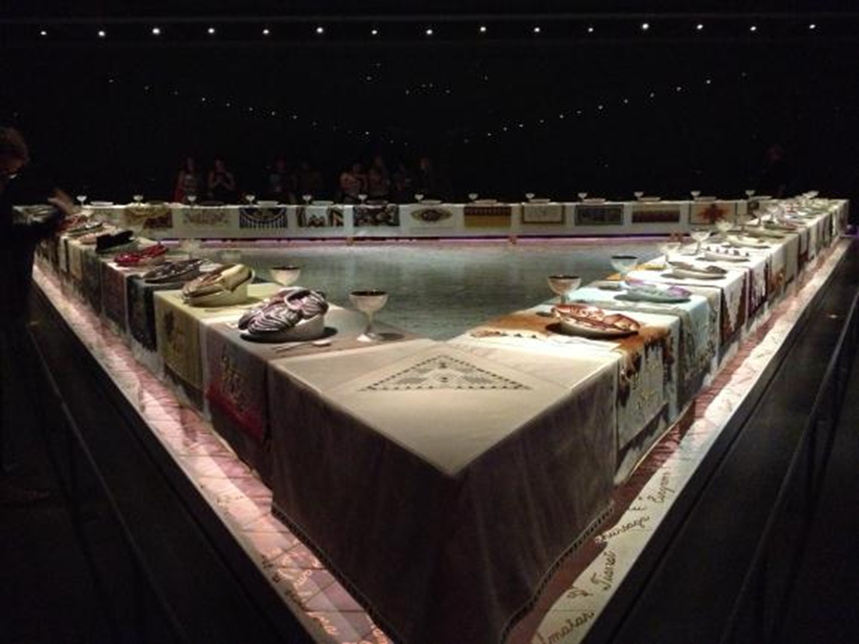
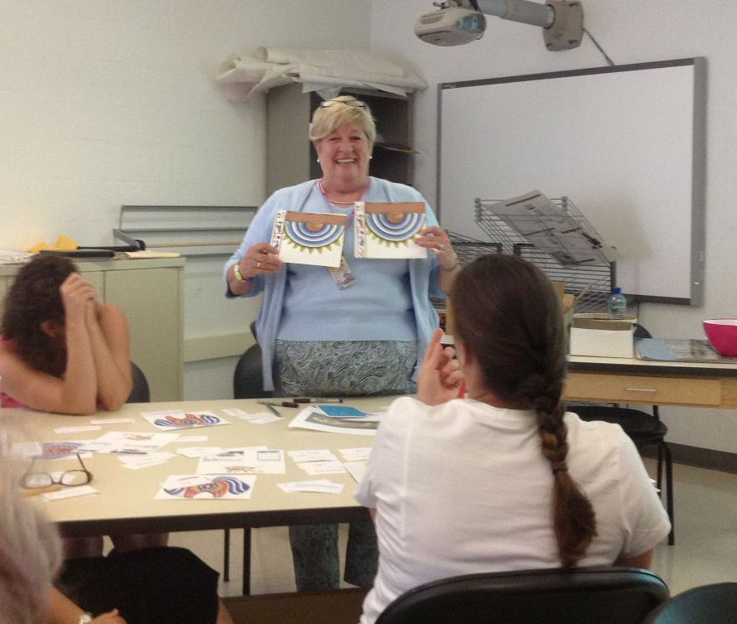
Always Learning
The Dinner Party Institute, Kutztown University, 2012

Slide 11
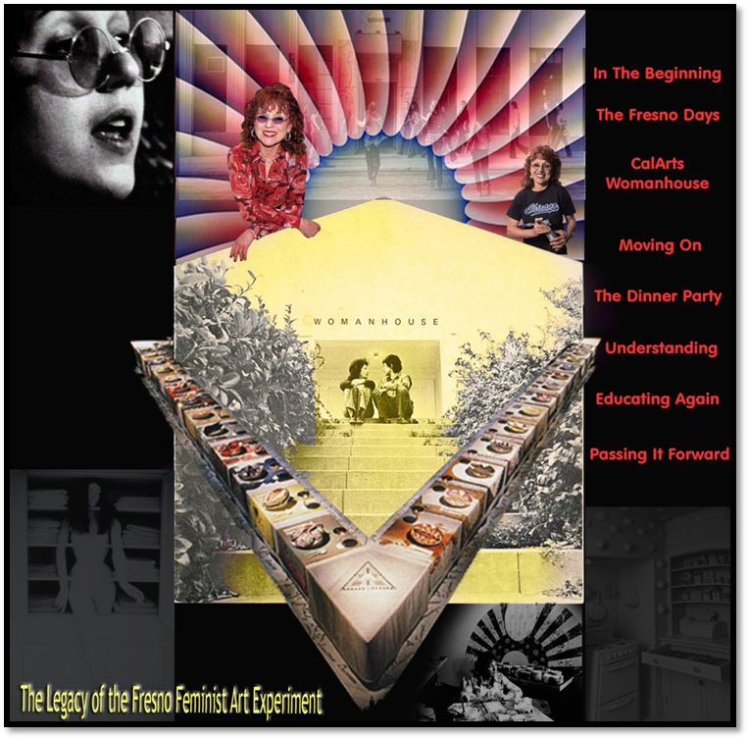
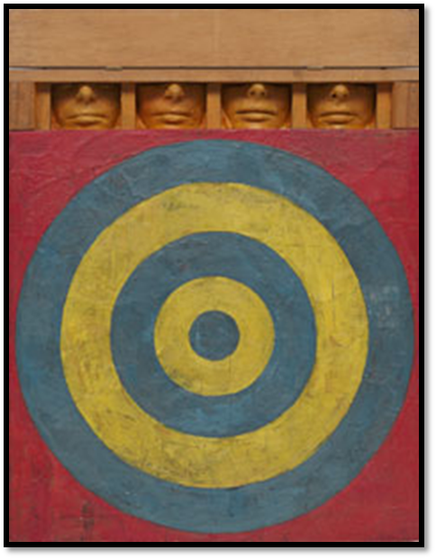
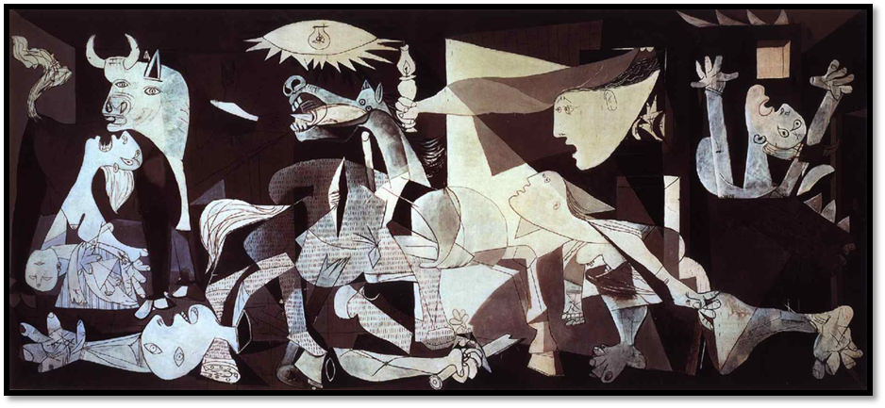
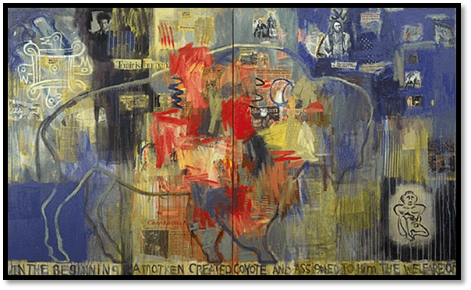
Artistic Influences

Slide 12
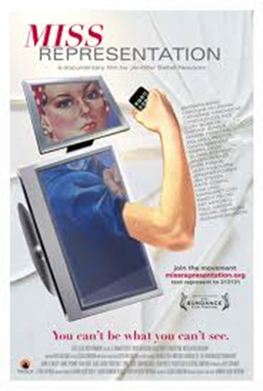
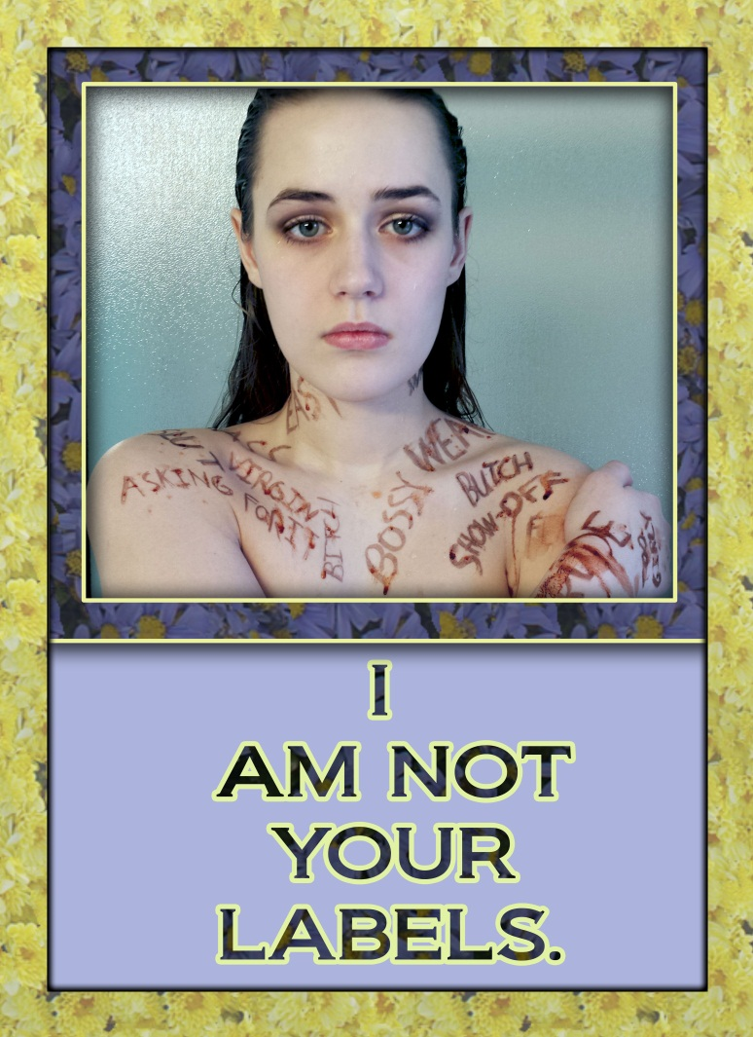
Making Connections – Seeking Resources
PHS Student - 2014

Slide 13
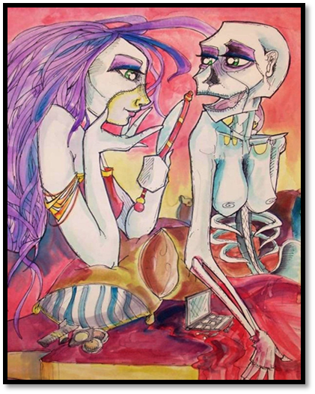
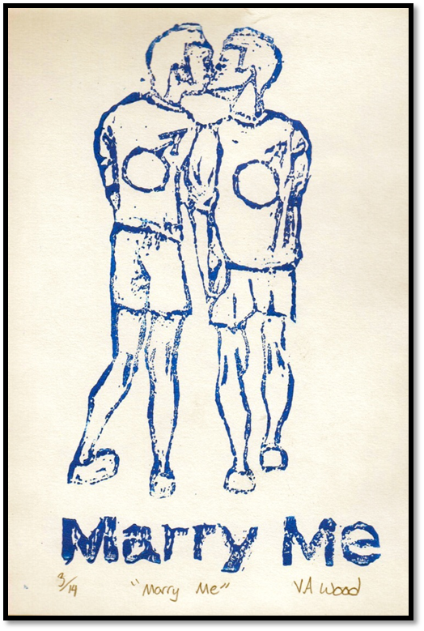
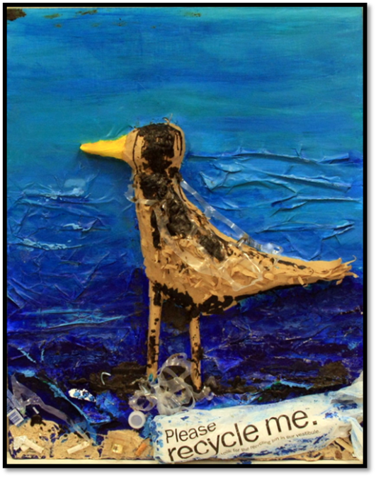
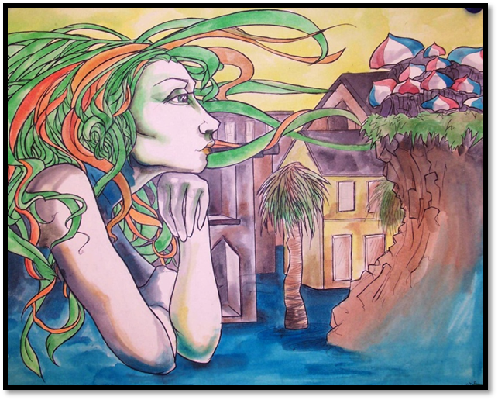
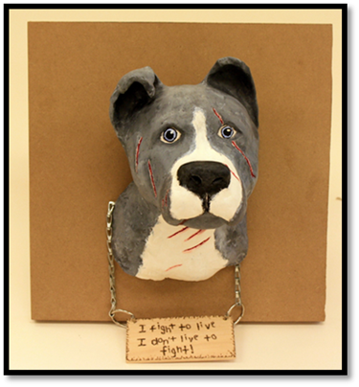
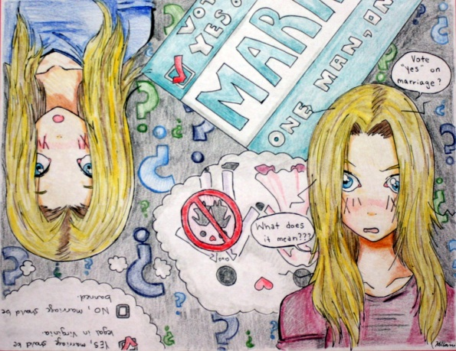
Current Events and Social Constructs
Marriage Equality

Slide 14
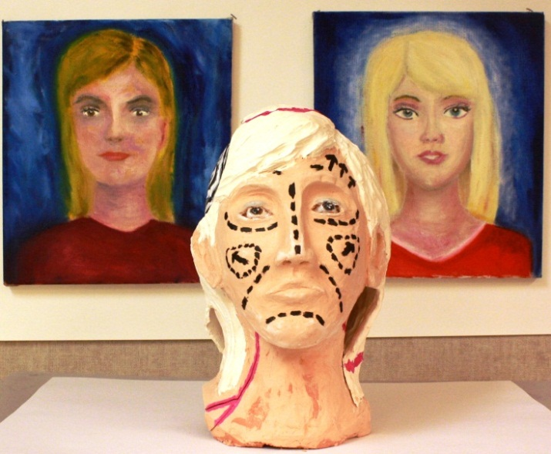
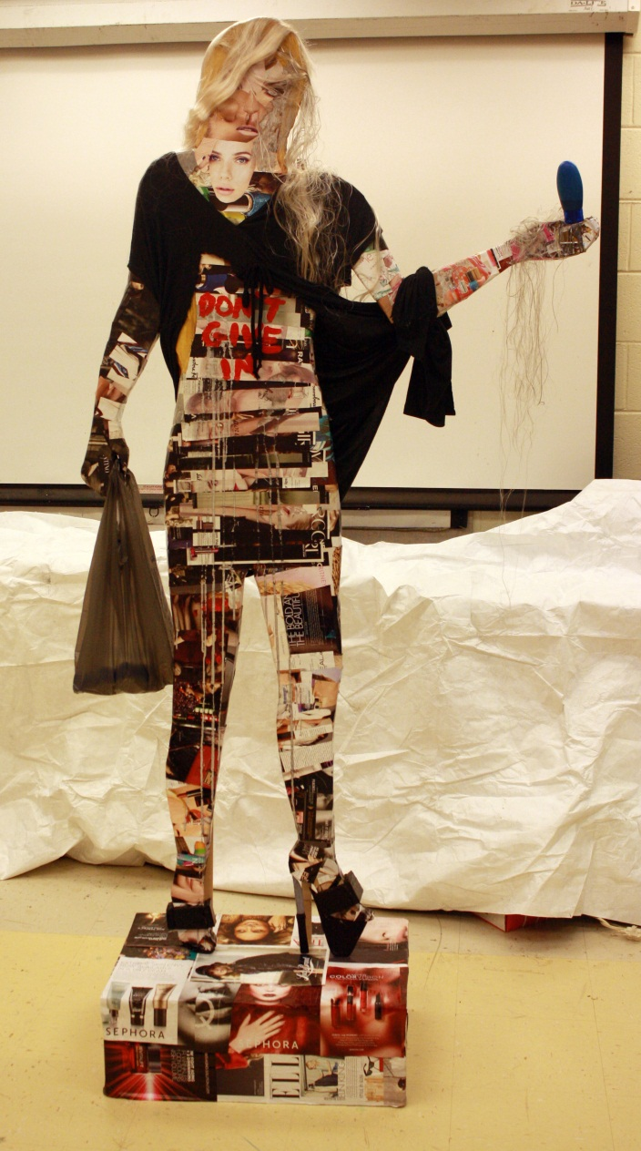
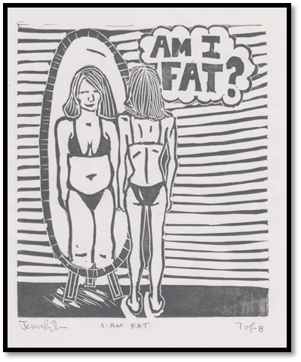
PHS
Student
Work

Slide 15
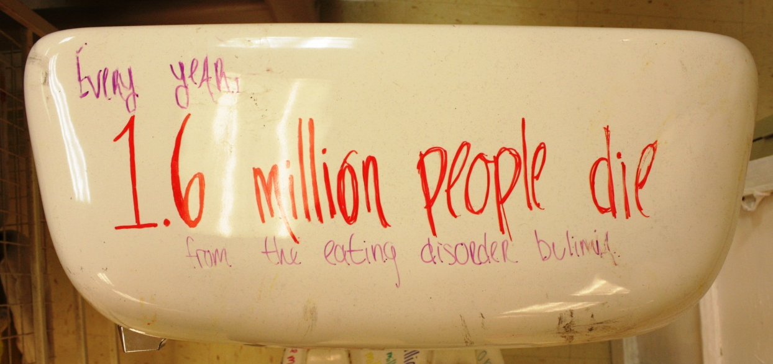
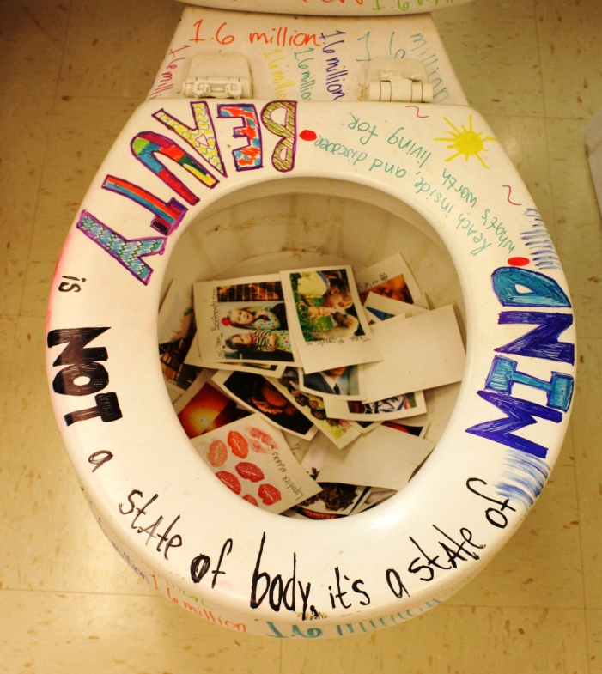
Research Based Art Creation

Slide 16
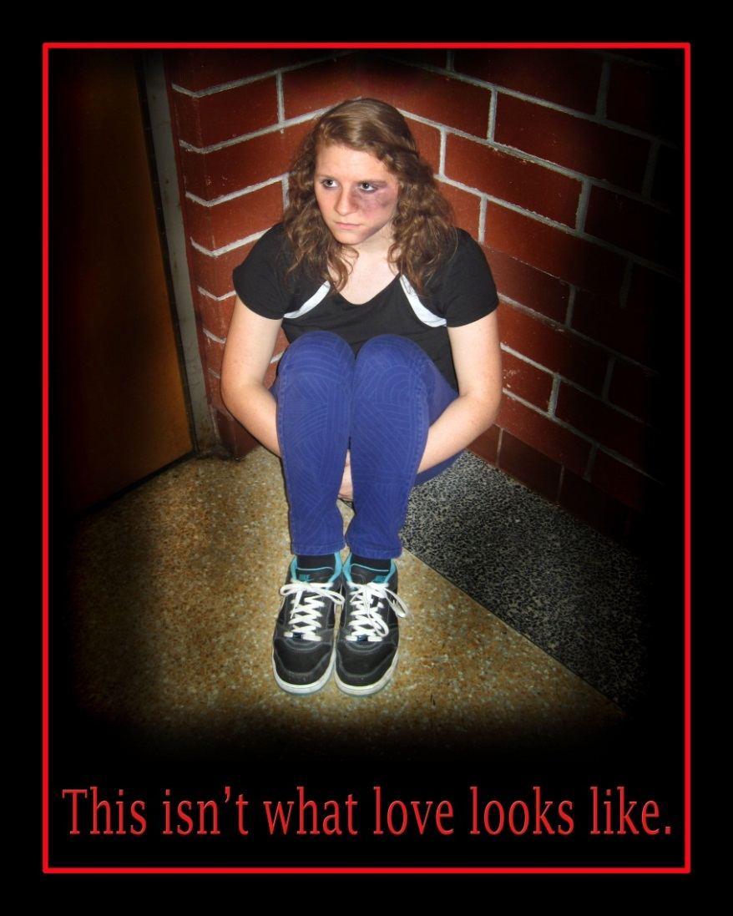
Awareness and Social Justice
PHS
Student
Art

Slide 17
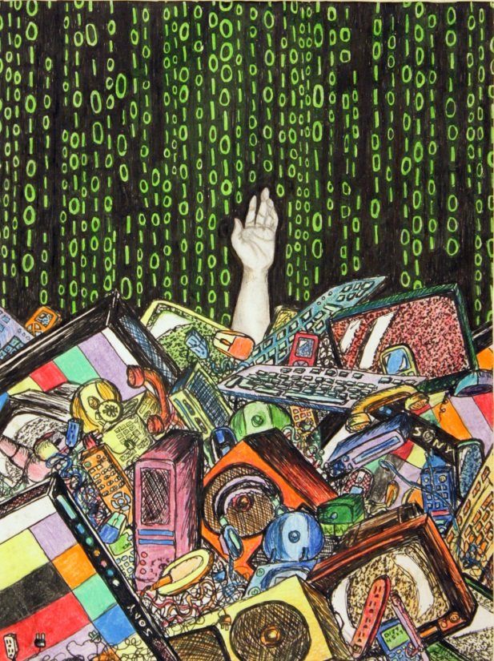
Drowning
in
Technology
Trapped
by the
Test
No More Money for Art
Notes:
My students tell me they often feel trapped by technology and testing. They see the prioity………. Which takes away time and money for arts.

Slide 18
From Collection to Creation

Slide 19
Notes:
Finding ways to connect Art History, Contemporary Art, Social Issues and Medi

Slide 20
New Life to Fallen Limbs
Student Work at Powhatan County Public Library
Student Sculpture Progress
Still Reaching Out, Wirt, 1997, Wood
Deborah Butterfiled
Notes:
The idea of giving new life to fallen limbs and investigating the work of Debora Butterfield found its way into my classroom with the creation of sculptures from fallen limbs around my rural school. After an exhibition at the county library one remains on permanent display

Slide 21
UpCycling with Eco Art

Slide 22
Plastic Bottles, Bags, Cans and Cardboard

Slide 23
PASSION
PRINCIPLES
PRODUCTION

Slide 24
PHS Student Work - 2014

